Slide 1
Galaxy Z Fold7
Tagging Guide

Slide 2
Common

Slide 3
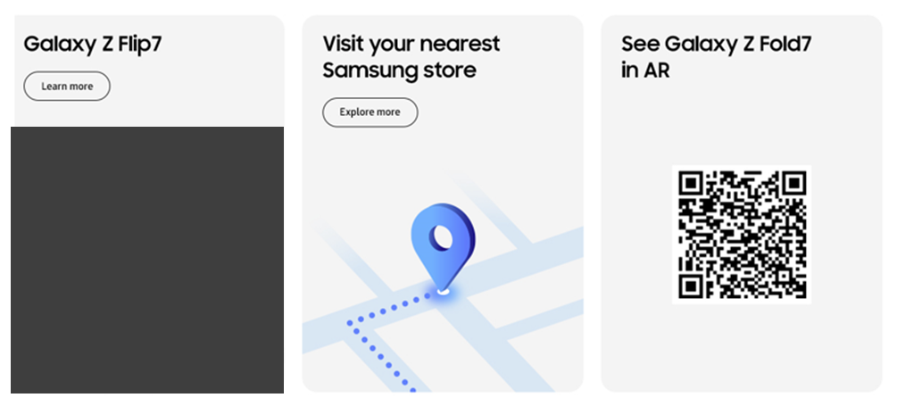
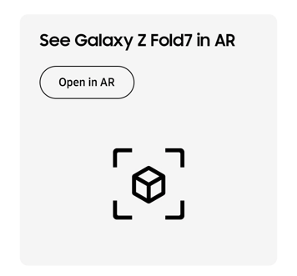
Common(Bottom Banner) - features
1
2
3
No. |  | Tagging Source
1 |  | Click to go Galaxy Z Flip7 MKT PD Features page
 | AA | data-omni-type="microsite_contentinter" data-omni="galaxy-z-fold7:features:bottom^bnn:link-page:galaxy-z-flip7"
 | GA | ga-ca="content click" ga-ac="feature" ga-la="galaxy-z-fold7:features:bottom^bnn:link-page:galaxy-z-flip7"
2 |  | Click to go Samsung Experience Store page
 | AA | data-omni-type="microsite_contentinter" data-omni="galaxy-z-fold7:features:bottom^bnn:link-page:samsung-experience-store"
 | GA | ga-ca="content click" ga-ac="feature" ga-la="galaxy-z-fold7:features:bottom^bnn:link-page:samsung-experience-store"
3 |  | Click to go Open in AR page
 | AA | data-omni-type="microsite_contentinter" data-omni="galaxy-z-fold7:features:bottom^bnn:link-page:open-in-ar"
 | GA | ga-ca="content click" ga-ac="feature" ga-la="galaxy-z-fold7:features:bottom^bnn:link-page:open-in-ar"

Slide 4
features

Slide 5
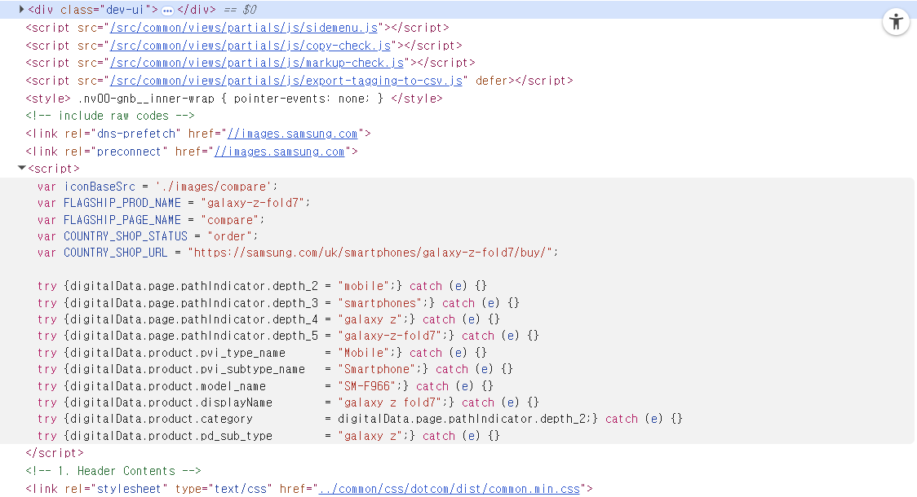
Page Track
1
2
3
5
4
7
6
8
10
9
No. | Tagging Source
1 | {depth2}
 | try {digitalData.page.pathIndicator.depth_2 = "mobile";} catch (e) {}
2 | {depth3}
 | try {digitalData.page.pathIndicator.depth_3 = "smartphones";} catch (e) {}
3 | {depth4}
 | try {digitalData.page.pathIndicator.depth_4 = "galaxy z";} catch (e) {}
4 | {depth5}
 | try {digitalData.page.pathIndicator.depth_5 = "galaxy-z-fold7";} catch (e) {}
5 | {pvi_type_neme}
 | try {digitalData.product.pvi_type_name = "Mobile";} catch (e) {}
6 | {pvi_sub_type_name}
 | try {digitalData.product.pvi_subtype_name = "Smartphone";} catch (e) {}
7 | {model_name}
 | try {digitalData.product.model_name = "SM-F966";} catch (e) {}
8 | {display_name}
 | try {digitalData.product.displayName = "galaxy z fold7";} catch (e) {}
9 | {category}
 | try {digitalData.product.category = digitalData.page.pathIndicator.depth_2;} catch (e) {}
10 | {pd_sub_type}
 | try {digitalData.product.pd_sub_type = "galaxy z";} catch (e) {}
Notes:
[Reference Code]
try {digitalData.page.pathIndicator.depth_2 = "mobile";} catch (e) {}
try {digitalData.page.pathIndicator.depth_3 = "smartphones";} catch (e) {}
try {digitalData.page.pathIndicator.depth_4 = "galaxy z";} catch (e) {}
try {digitalData.page.pathIndicator.depth_5 = "galaxy-zfold-7";} catch (e) {}
try {digitalData.product.pvi_type_name = "Mobile";} catch (e) {}
try {digitalData.product.pvi_subtype_name = "Smartphone";} catch (e) {}
try {digitalData.product.model_name = "SM-z937";} catch (e) {}
try {digitalData.product.displayName = "galaxy zfold7 ";} catch (e) {}
try {digitalData.product.category = digitalData.page.pathIndicator.depth_2;} catch (e) {}
try {digitalData.product.pd_sub_type = "galaxy z";} catch (e) {}

Slide 6
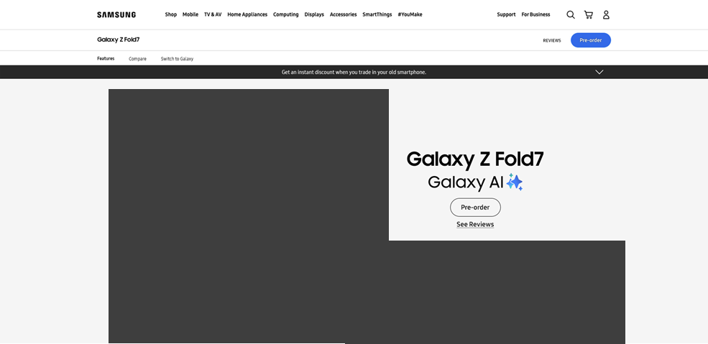
Features-KV
1
2
3
4
No. |  | Tagging Source
1 |  | KV Drop down - Open
 | AA | data-omni-type="microsite_contentinter" data-omni="galaxy-z-fold7:features:kv:acdn-open:offer"
 | GA | ga-ca="indication" ga-ac="accordion" ga-la="galaxy-z-fold7:features:kv:acdn-open:offer"
2 |  | KV Drop down - Close
 | AA | data-omni-type="microsite_contentinter" data-omni="galaxy-z-fold7:features:kv:acdn-close:offer"
 | GA | ga-ca="indication" ga-ac="accordion" ga-la="galaxy-z-fold7:features:kv:acdn-close:offer"
3 |  | Pre-order
 | AA | data-omni-type="microsite_buyAction" data-omni="galaxy-z-fold7:features:key-vis^img:conv-pdt:pre-order|;SM-F966"
 | GA | ga-ca="buy cta" ga-ac="pre-order" ga-la="galaxy-z-fold7:features:key-vis^img:conv-pdt:pre-order"
 |  | Buy now
 | AA | data-omni-type="microsite_buyAction" data-omni="galaxy-z-fold7:features:key-vis^img:conv-pdt:buy-now|;SM-F966"
 | GA | ga-ca="buy cta" ga-ac="buy-now" ga-la="galaxy-z-fold7:features:key-vis^img:conv-pdt:buy-now"
 |  | Reserve
 | AA | data-omni-type="microsite_buyAction" data-omni="galaxy-z-fold7:features:key-vis^img:conv-pdt:reserve|;SM-F966"
 | GA | ga-ca="buy cta" ga-ac="reserve-now" ga-la="galaxy-z-fold7:features:key-vis^img:conv-pdt:reserve"
 |  | Where to buy
 | AA | data-omni-type="microsite_buyAction" data-omni="galaxy-z-fold7:features:key-vis^img:conv-pdt:where-to-buy|;SM-F966"
 | GA | ga-ca="buy cta" ga-ac="where-to-buy" ga-la="galaxy-z-fold7:features:key-vis^img:conv-pdt:where-to-buy"
4 |  | Click to go See Reviews page
 | AA | data-omni-type="microsite_contentinter" data-omni="galaxy-z-fold7:features:kv:link-page:see-reviews"
 | GA | ga-ca="content click" ga-ac="feature" ga-la="galaxy-z-fold7:features:kv:link-page:see-reviews"

Slide 7
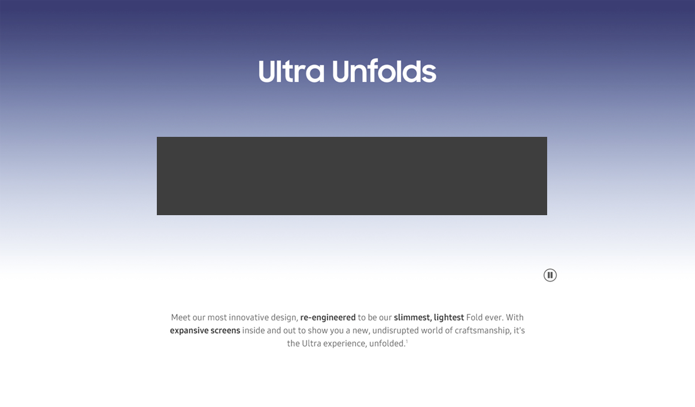

Features-Unveiling
1
2
No. |  | Tagging Source
1 |  | Click to Play
 | AA | data-omni-type="microsite_contentinter" data-omni="galaxy-z-fold7:features:unveiling:movi-play:main-movie"
 | GA | ga-ca="content click" ga-ac="feature" ga-la="galaxy-z-fold7:features:unveiling:movi-play:main-movie"
2 |  | Click to Pause
 | AA | data-omni-type="microsite_contentinter" data-omni="galaxy-z-fold7:features:unveiling:movi-pause:main-movie"
 | GA | ga-ca="content click" ga-ac="feature" ga-la="galaxy-z-fold7:features:unveiling:movi-pause:main-movie"

Slide 8
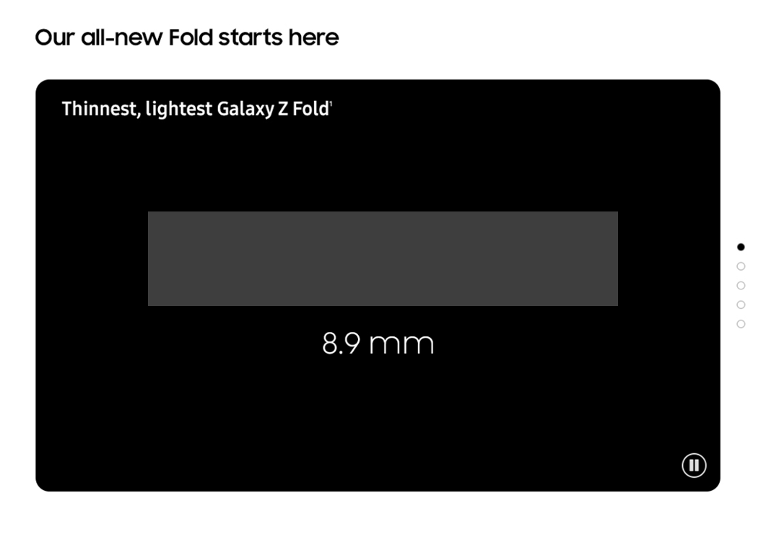

Features-Highlights (1/4)
3
4
5
6
7
1
2
No. |  | Tagging Source
1 |  | Click to Play
 | AA | data-omni-type="microsite_contentinter" data-omni="galaxy-z-fold7:features:highlights^design:movi-play:main-movie"
 | GA | ga-ca="content click" ga-ac="feature" ga-la="galaxy-z-fold7:features:highlights^design:movi-play:main-movie"
2 |  | Click to Pause
 | AA | data-omni-type="microsite_contentinter" data-omni="galaxy-z-fold7:features:highlights^design:movi-pause:main-movie"
 | GA | ga-ca="content click" ga-ac="feature" ga-la="galaxy-z-fold7:features:highlights^design:movi-pause:main-movie"
3 |  | Click to Carousel
 | AA | data-omni-type="microsite_contentinter” data-omni="galaxy-z-fold7:features:highlights:index:design"
 | GA | ga-ca="gallery" ga-ac="feature gallery" ga-la="galaxy-z-fold7:features:highlights:index:design"
4 |  | Click to Carouse2
 | AA | data-omni-type="microsite_contentinter” data-omni="galaxy-z-fold7:features:highlights:index:camera"
 | GA | ga-ca="gallery" ga-ac="feature gallery" ga-la="galaxy-z-fold7:features:highlights:index:camera"
5 |  | Click to Carouse3
 | AA | data-omni-type="microsite_contentinter” data-omni="galaxy-z-fold7:features:highlights:index:ap"
 | GA | ga-ca="gallery" ga-ac="feature gallery" ga-la="galaxy-z-fold7:features:highlights:index:ap"
6 |  | Click to Carouse4
 | AA | data-omni-type="microsite_contentinter” data-omni="galaxy-z-fold7:features:highlights:index:battery"
 | GA | ga-ca="gallery" ga-ac="feature gallery" ga-la="galaxy-z-fold7:features:highlights:index:battery"
7 |  | Click to Carouse5
 | AA | data-omni-type="microsite_contentinter” data-omni="galaxy-z-fold7:features:highlights:index:ai”
 | GA | ga-ca="gallery" ga-ac="feature gallery" ga-la="galaxy-z-fold7:features:highlights:index:ai"

Slide 9
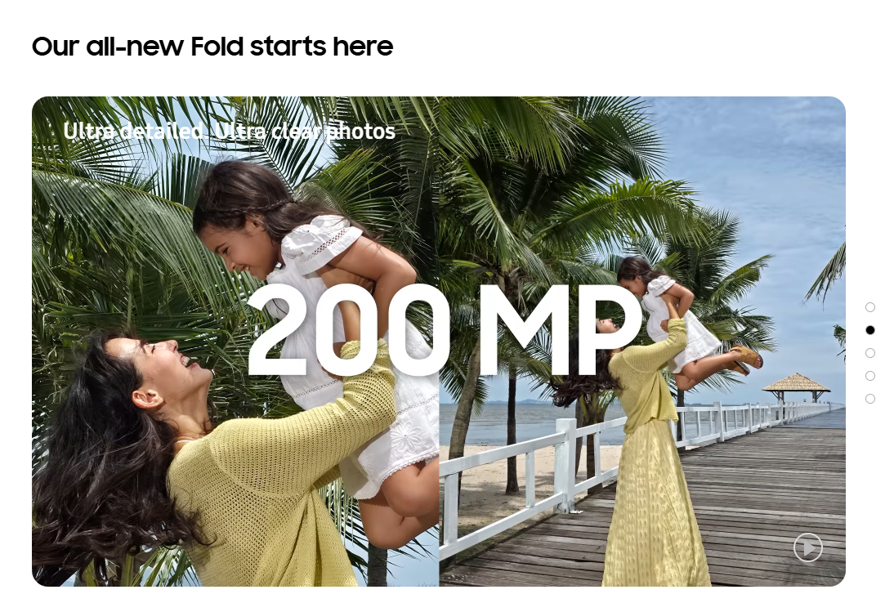


Features-Highlights (2/4)
1
2
No. |  | Tagging Source
1 |  | Click to Play
 | AA | data-omni-type="microsite_contentinter" data-omni="galaxy-z-fold7:features:highlights^camera:movi-play:main-movie"
 | GA | ga-ca="content click" ga-ac="feature" ga-la="galaxy-z-fold7:features:highlights^camera:movi-play:main-movie"
2 |  | Click to Pause
 | AA | data-omni-type="microsite_contentinter" data-omni="galaxy-z-fold7:features:highlights^camera:movi-pause:main-movie"
 | GA | ga-ca="content click" ga-ac="feature" ga-la="galaxy-z-fold7:features:highlights^camera:movi-pause:main-movie"

Slide 10
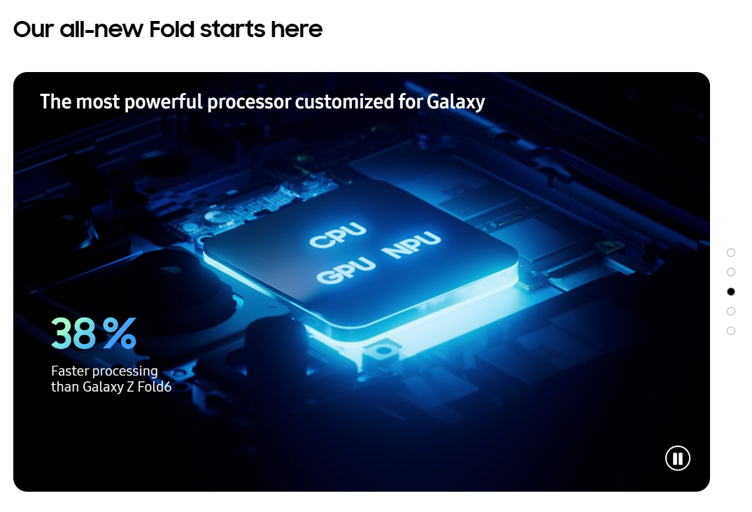

Features-Highlights (3/4)
1
2
No. |  | Tagging Source
1 |  | Click to Play
 | AA | data-omni-type="microsite_contentinter" data-omni="galaxy-z-fold7:features:highlights^ap:movi-play:main-movie"
 | GA | ga-ca="content click" ga-ac="feature" ga-la="galaxy-z-fold7:features:highlights^ap:movi-play:main-movie"
2 |  | Click to Pause
 | AA | data-omni-type="microsite_contentinter" data-omni="galaxy-z-fold7:features:highlights^ap:movi-pause:main-movie"
 | GA | ga-ca="content click" ga-ac="feature" ga-la="galaxy-z-fold7:features:highlights^ap:movi-pause:main-movie"

Slide 11
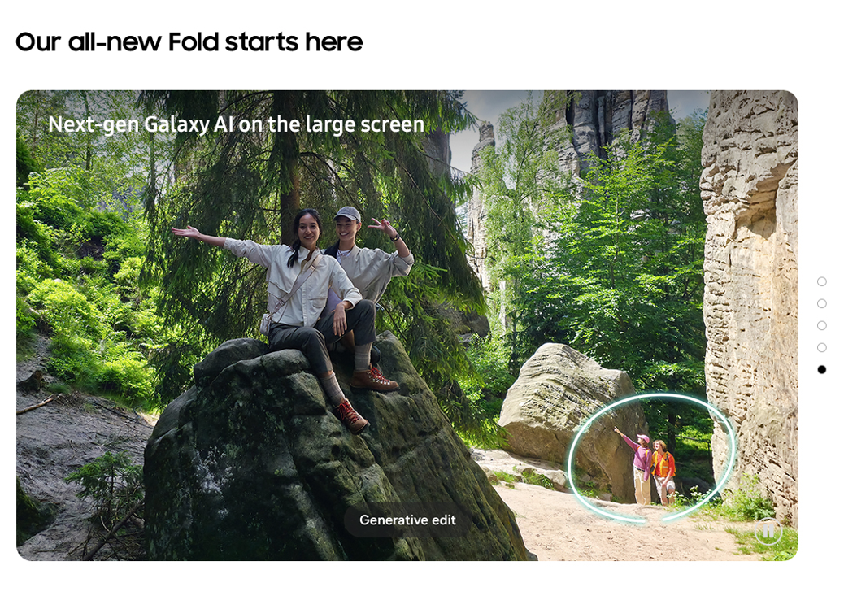

Features-Highlights (4/4)
1
2
No. |  | Tagging Source
1 |  | Click to Play
 | AA | data-omni-type="microsite_contentinter" data-omni="galaxy-z-fold7:features:highlights^ai:movi-play:main-movie"
 | GA | ga-ca="content click" ga-ac="feature" ga-la="galaxy-z-fold7:features:highlights^ai:movi-play:main-movie"
2 |  | Click to Pause
 | AA | data-omni-type="microsite_contentinter" data-omni="galaxy-z-fold7:features:highlights^ai:movi-pause:main-movie"
 | GA | ga-ca="content click" ga-ac="feature" ga-la="galaxy-z-fold7:features:highlights^ai:movi-pause:main-movie"

Slide 12
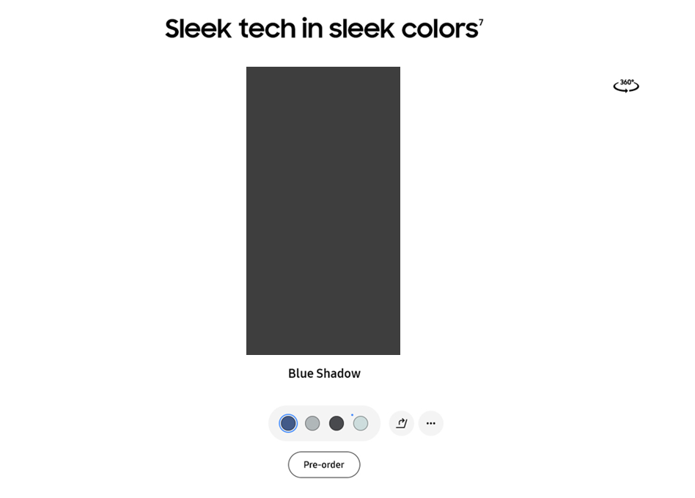
Features-Colors(1/3)
1
2
3
4
5
No. |  | Tagging Source
1 |  | Colorchip – Blue Shadow
 | AA | data-omni-type="microsite_contentinter" data-omni="galaxy-z-fold7:features:design^colors:slct-color:galaxy-z-fold7^blue-shadow"
 | GA | ga-ca="gallery" ga-ac="feature gallery" ga-la="galaxy-z-fold7:features:design^colors:slct-color:galaxy-z-fold7^blue-shadow"
2 |  | Colorchip – Silver Shadow
 | AA | data-omni-type="microsite_contentinter" data-omni="galaxy-z-fold7:features:design^colors:slct-color:galaxy-z-fold7^silver-shadow"
 | GA | ga-ca="gallery" ga-ac="feature gallery" ga-la="galaxy-z-fold7:features:design^colors:slct-color:galaxy-z-fold7^silver-shadow"
3 |  | Colorchip – JetBlack
 | AA | data-omni-type="microsite_contentinter" data-omni="galaxy-z-fold7:features:design^colors:slct-color:galaxy-z-fold7^jetblack"
 | GA | ga-ca="gallery" ga-ac="feature gallery" ga-la="galaxy-z-fold7:features:design^colors:slct-color:galaxy-z-fold7^jetblack"
4 |  | Colorchip – Online exclusive > Mint
 | AA | data-omni-type="microsite_contentinter" data-omni="galaxy-z-fold7:features:design^exclusivecolors:slct-color:galaxy-z-fold7^mint"
 | GA | ga-ca="gallery" ga-ac="feature gallery" ga-la="galaxy-z-fold7:features:design^exclusivecolors:slct-color:galaxy-z-fold7^mint"
5 |  | Pre-order
 | AA | data-omni-type="microsite_buyAction" data-omni="galaxy-z-fold7:features:design^colors:conv-pdt:pre-order|;SM-F966"
 | GA | ga-ca="buy cta" ga-ac="pre-order" ga-la="galaxy-z-fold7:features:design^colors:conv-pdt:pre-order"
 |  | Buy now
 | AA | data-omni-type="microsite_buyAction" data-omni="galaxy-z-fold7:features:design^colors:conv-pdt:buy-now|;SM-F966"
 | GA | ga-ca="buy cta" ga-ac="buy-now" ga-la="galaxy-z-fold7:features:design^colors:conv-pdt:buy-now"
 |  | Reserve
 | AA | data-omni-type="microsite_buyAction" data-omni="galaxy-z-fold7:features:design^colors:conv-pdt:reserve|;SM-F966"
 | GA | ga-ca="buy cta" ga-ac="reserve-now" ga-la="galaxy-z-fold7:features:design^colors:conv-pdt:reserve"
 |  | Where to buy
 | AA | data-omni-type="microsite_buyAction" data-omni="galaxy-z-fold7:features:design^colors:conv-pdt:where-to-buy|;SM-F966"
 | GA | ga-ca="buy cta" ga-ac="where-to-buy" ga-la="galaxy-z-fold7:features:design^colors:conv-pdt:where-to-buy"

Slide 13
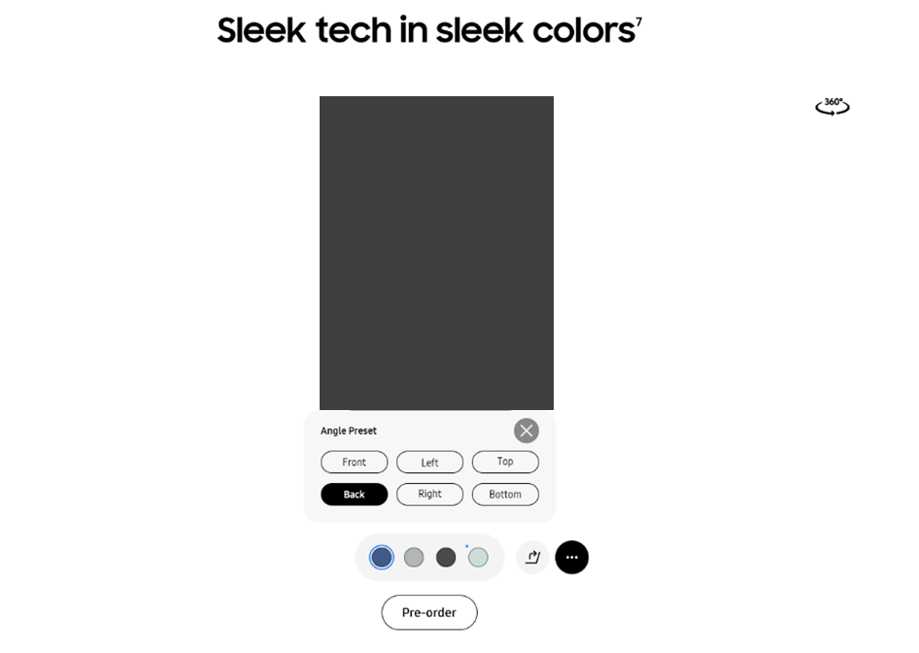

Features-Colors(2/3)
1
3
2
No. |  | Tagging Source
1 |  | Unfold Button
 | AA | data-omni-type="microsite_contentinter" data-omni="galaxy-z-fold7:features:design^colors:slct-fold:galaxy-z-fold7^unfolded"
 | GA | ga-ca="content click" ga-ac="feature" ga-la="galaxy-z-fold7:features:design^colors:slct-fold:galaxy-z-fold7^unfolded"
2 |  | fold Button
 | AA | data-omni-type="microsite_contentinter" data-omni="galaxy-z-fold7:features:design^colors:slct-fold:galaxy-z-fold7^folded"
 | GA | ga-ca="content click" ga-ac="feature" ga-la="galaxy-z-fold7:features:design^colors:slct-fold:galaxy-z-fold7^folded"
3 |  | Angle Preset Button
 | AA | data-omni-type="microsite_contentinter" data-omni="galaxy-z-fold7:features:design^colors:lypu-open:galaxy-z-fold7^angle-preset"
 | GA | ga-ca="content click" ga-ac="feature" ga-la="galaxy-z-fold7:features:design^colors:lypu-open:galaxy-z-fold7^angle-preset"

Slide 14
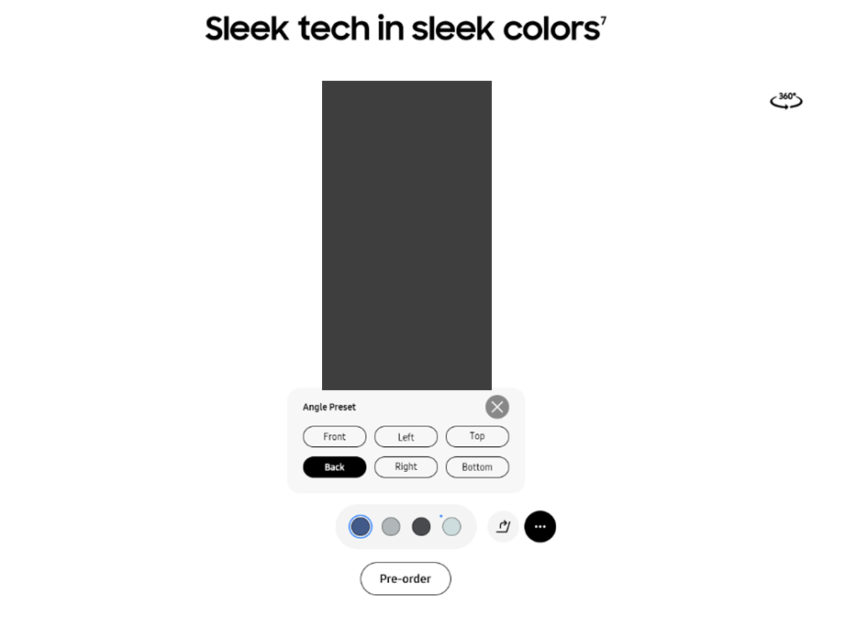
Features-Colors(3/3)
2
3
4
1
5
6
7
No. |  | Tagging Source
1 |  | Angle preset pop-up close
 | AA | data-omni-type="microsite_contentinter" data-omni="galaxy-z-fold7:features:design^colors:lypu-close:galaxy-z-fold7^angle-preset"
 | GA | ga-ca="content click" ga-ac="feature" ga-la="galaxy-z-fold7:features:design^colors:lypu-close:galaxy-z-fold7^angle-preset"
2 |  | Front angle
 | AA | data-omni-type="microsite_contentinter" data-omni="galaxy-z-fold7:features:design^colors:slct-angle:galaxy-z-fold7^front"
 | GA | ga-ca="content click" ga-ac="feature" ga-la="galaxy-z-fold7:features:design^colors:slct-angle:galaxy-z-fold7^front"
3 |  | Left angle
 | AA | data-omni-type="microsite_contentinter" data-omni="galaxy-z-fold7:features:design^colors:slct-angle:galaxy-z-fold7^left"
 | GA | ga-ca="content click" ga-ac="feature" ga-la="galaxy-z-fold7:features:design^colors:slct-angle:galaxy-z-fold7^left"
4 |  | Top angle
 | AA | data-omni-type="microsite_contentinter" data-omni="galaxy-z-fold7:features:design^colors:slct-angle:galaxy-z-fold7^top"
 | GA | ga-ca="content click" ga-ac="feature" ga-la="galaxy-z-fold7:features:design^colors:slct-angle:galaxy-z-fold7^top"
5 |  | Back angle
 |  | data-omni-type="microsite_contentinter" data-omni="galaxy-z-fold7:features:design^colors:slct-angle:galaxy-z-fold7^back"
 |  | ga-ca="content click" ga-ac="feature" ga-la="galaxy-z-fold7:features:design^colors:slct-angle:galaxy-z-fold7^back"
6 |  | Right angle
 | AA | data-omni-type="microsite_contentinter" data-omni="galaxy-z-fold7:features:design^colors:slct-angle:galaxy-z-fold7^right"
 | GA | ga-ca="content click" ga-ac="feature" ga-la="galaxy-z-fold7:features:design^colors:slct-angle:galaxy-z-fold7^right"
7 |  | Bottom angle
 | AA | data-omni-type="microsite_contentinter" data-omni="galaxy-z-fold7:features:design^colors:slct-angle:galaxy-z-fold7^bottom"
 | GA | ga-ca="content click" ga-ac="feature" ga-la="galaxy-z-fold7:features:design^colors:slct-angle:galaxy-z-fold7^bottom"

Slide 15
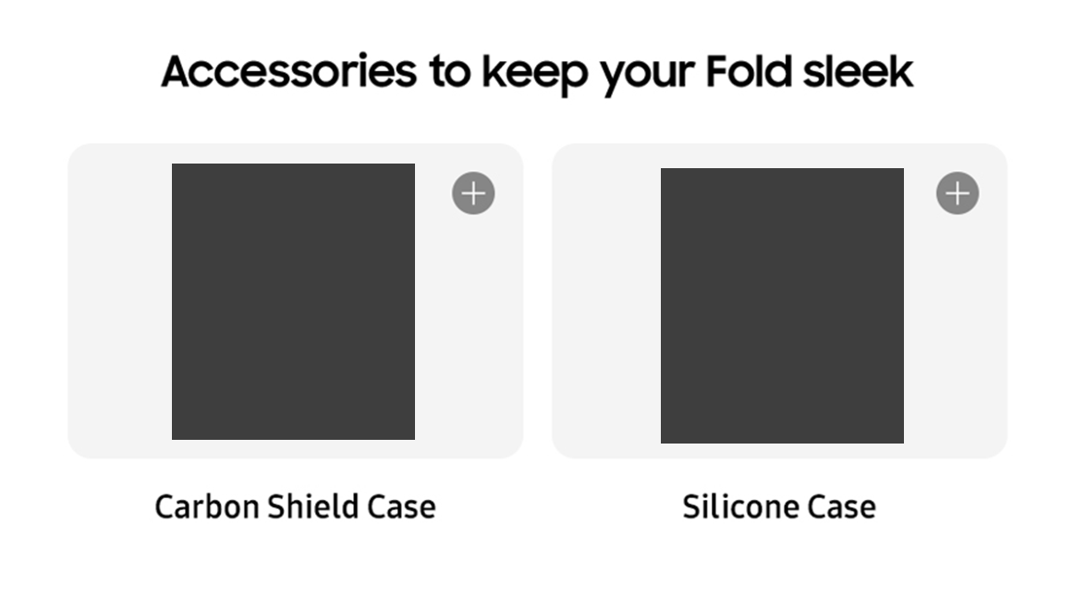
Features-Acc Banner
1
2
No. |  | Tagging Source
1 |  | Click to Open Pop up
 | AA | data-omni-type="microsite_contentinter" data-omni="galaxy-z-fold7:features:design^accessories:lypu-open:carbon-shield-case"
 | GA | ga-ca="content click" ga-ac="feature" ga-la="galaxy-z-fold7:features:design^accessories:lypu-open:carbon-shield-case"
2 |  | Click to Open Pop up
 | AA | data-omni-type="microsite_contentinter" data-omni="galaxy-z-fold7:features:design^accessories:lypu-open:silicone-case"
 | GA | ga-ca="content click" ga-ac="feature" ga-la="galaxy-z-fold7:features:design^accessories:lypu-open:silicone-case"

Slide 16
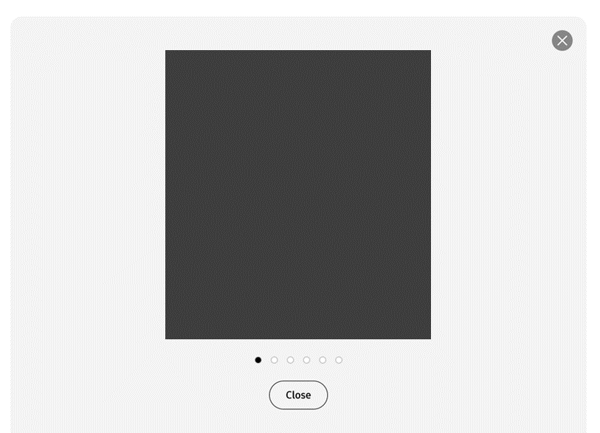
Features-Acc Pop Up (Carbon Shield Case)
1
3
4
5
6
7
8
2
No. |  | Tagging Source
1 |  | Click to Close Pop up
 | AA | data-omni-type="microsite_contentinter" data-omni="galaxy-z-fold7:features:design^accessories^carbon-shield-case-popup:lypu-close1:close"
 | GA | ga-ca="content click" ga-ac="feature" ga-la="galaxy-z-fold7:features:design^accessories^carbon-shield-case-popup:lypu-close1:close"
2 |  | Click to Close Pop up
 | AA | data-omni-type="microsite_contentinter" data-omni="galaxy-z-fold7:features:design^accessories^carbon-shield-case-popup:lypu-close2:close"
 | GA | ga-ca="content click" ga-ac="feature" ga-la="galaxy-z-fold7:features:design^accessories^carbon-shield-case-popup:lypu-close2:close"
3 |  | Click to Carousel
 | AA | data-omni-type="microsite_contentinter" data-omni="galaxy-z-fold7:features:design^accessories^carbon-shield-case-popup:index:1"
 | GA | ga-ca="gallery" ga-ac="feature gallery" ga-la="galaxy-z-fold7:features:design^accessories^carbon-shield-case-popup:index:1"
4 |  | Click to Carouse2
 | AA | data-omni-type="microsite_contentinter" data-omni="galaxy-z-fold7:features:design^accessories^carbon-shield-case-popup:index:2"
 | GA | ga-ca="gallery" ga-ac="feature gallery" ga-la="galaxy-z-fold7:features:design^accessories^carbon-shield-case-popup:index:2"
5 |  | Click to Carouse3
 | AA | data-omni-type=""microsite_contentinter" data-omni="galaxy-z-fold7:features:design^accessories^carbon-shield-case-popup:index:3"
 | GA | ga-ca="gallery" ga-ac="feature gallery" ga-la="galaxy-z-fold7:features:design^accessories^carbon-shield-case-popup:index:3"
6 |  | Click to Carouse4
 | AA | data-omni-type=""microsite_contentinter" data-omni="galaxy-z-fold7:features:design^accessories^carbon-shield-case-popup:index:4"
 | GA | ga-ca="gallery" ga-ac="feature gallery" ga-la="galaxy-z-fold7:features:design^accessories^carbon-shield-case-popup:index:4"
7 |  | Click to Carouse5
 | AA | data-omni-type=""microsite_contentinter" data-omni="galaxy-z-fold7:features:design^accessories^carbon-shield-case-popup:index:5"
 | GA | ga-ca="gallery" ga-ac="feature gallery" ga-la="galaxy-z-fold7:features:design^accessories^carbon-shield-case-popup:index:5"
8 |  | Click to Carouse6
 | AA | data-omni-type=""microsite_contentinter" data-omni="galaxy-z-fold7:features:design^accessories^carbon-shield-case-popup:index:6"
 | GA | ga-ca="gallery" ga-ac="feature gallery" ga-la="galaxy-z-fold7:features:design^accessories^carbon-shield-case-popup:index:6"

Slide 17
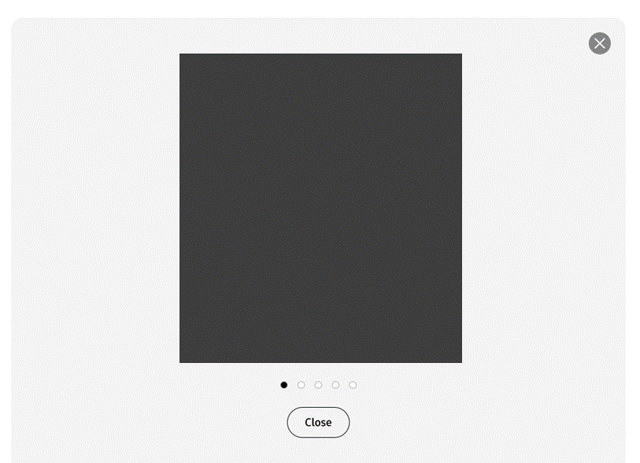
Features-Acc Pop Up (Silicone Case)
1
3
4
5
6
7
2
No. |  | Tagging Source
1 |  | Click to Close Pop up
 | AA | data-omni-type="microsite_contentinter" data-omni="galaxy-z-fold7:features:design^accessories^silicone-case-popup:lypu-close1:close"
 | GA | ga-ca="content click" ga-ac="feature" ga-la="galaxy-z-fold7:features:design^accessories^silicone-case-popup:lypu-close1:close"
2 |  | Click to Close Pop up
 | AA | data-omni-type="microsite_contentinter" data-omni="galaxy-z-fold7:features:design^accessories^silicone-case-popup:lypu-close2:close"
 | GA | ga-ca="content click" ga-ac="feature" ga-la="galaxy-z-fold7:features:design^accessories^silicone-case-popup:lypu-close2:close"
3 |  | Click to Carousel
 | AA | data-omni-type=""microsite_contentinter" data-omni="galaxy-z-fold7:features:design^accessories^silicone-case-popup:index:1"
 | GA | ga-ca="gallery" ga-ac="feature gallery" ga-la="galaxy-z-fold7:features:design^accessories^silicone-case-popup:index:1"
4 |  | Click to Carouse2
 | AA | data-omni-type=""microsite_contentinter" data-omni="galaxy-z-fold7:features:design^accessories^silicone-case-popup:index:2"
 | GA | ga-ca="gallery" ga-ac="feature gallery" ga-la="galaxy-z-fold7:features:design^accessories^silicone-case-popup:index:2"
5 |  | Click to Carouse3
 | AA | data-omni-type=""microsite_contentinter" data-omni="galaxy-z-fold7:features:design^accessories^silicone-case-popup:index:3"
 | GA | ga-ca="gallery" ga-ac="feature gallery" ga-la="galaxy-z-fold7:features:design^accessories^silicone-case-popup:index:3"
6 |  | Click to Carouse4
 | AA | data-omni-type=""microsite_contentinter" data-omni="galaxy-z-fold7:features:design^accessories^silicone-case-popup:index:4"
 | GA | ga-ca="gallery" ga-ac="feature gallery" ga-la="galaxy-z-fold7:features:design^accessories^silicone-case-popup:index:4"
7 |  | Click to Carouse5
 | AA | data-omni-type=""microsite_contentinter" data-omni="galaxy-z-fold7:features:design^accessories^silicone-case-popup:index:5"
 | GA | ga-ca="gallery" ga-ac="feature gallery" ga-la="galaxy-z-fold7:features:design^accessories^silicone-case-popup:index:5"

Slide 18
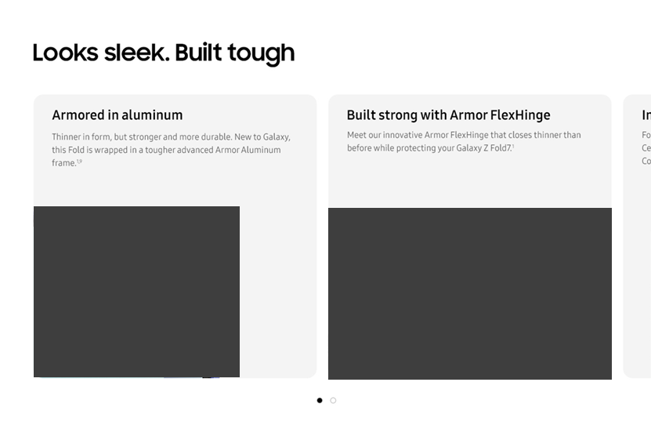
Features-Durability
1
2
No. |  | Tagging Source
1 |  | Click to Indicator 1
 | AA | data-omni-type="microsite_contentinter" data-omni="galaxy-z-fold7:features:design^durability:index:1"
 | GA | ga-ca="gallery" ga-ac="feature gallery" ga-la="galaxy-z-fold7:features:design^durability:index:1"
2 |  | Click to Indicator 2
 | AA | data-omni-type="microsite_contentinter" data-omni="galaxy-z-fold7:features:design^durability:index:2"
 | GA | ga-ca="gallery" ga-ac="feature gallery" ga-la="galaxy-z-fold7:features:design^durability:index:2"

Slide 19
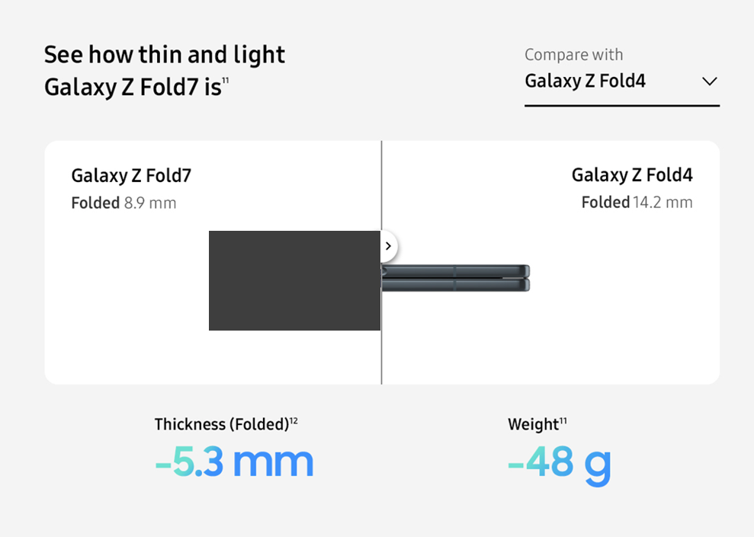
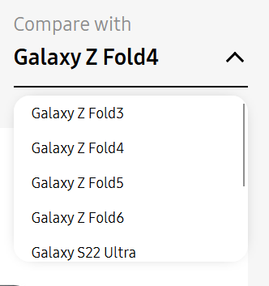
Features-Design Compare (1/3)
1
2
No. |  | Tagging Source
1 |  | Open Compare List
 | AA | data-omni-type="microsite_contentinter" data-omni="galaxy-z-fold7:features:design^size-compare:slct-device-open:pre"
 | GA | ga-ca="content click" ga-ac="feature" ga-la="galaxy-z-fold7:features:design^size-compare:slct-device-open:pre"
2 |  | Close Compare List
 | AA | data-omni-type="microsite_contentinter" data-omni="galaxy-z-fold7:features:design^size-compare:slct-device-close:pre"
 | GA | ga-ca="content click" ga-ac="feature" ga-la="galaxy-z-fold7:features:design^size-compare:slct-device-close:pre"

Slide 20
Features-Design Compare (2/3)
1
2
No. |  | Tagging Source
1 |  | split move left
 | AA | data-omni-type="microsite_contentinter" data-omni="galaxy-z-fold7:features:design^size-compare:split-screen-move:left"
 | GA | ga-ca="content click" ga-ac="feature" ga-la="galaxy-z-fold7:features:design^size-compare:split-screen-move:left"
2 |  | split move right
 | AA | data-omni-type="microsite_contentinter" data-omni="galaxy-z-fold7:features:design^size-compare:split-screen-move:right"
 | GA | ga-ca="content click" ga-ac="feature" ga-la="galaxy-z-fold7:features:design^size-compare:split-screen-move:right"

Slide 21
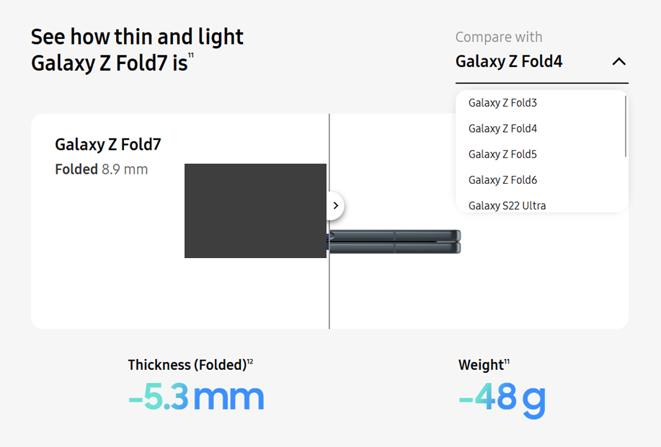
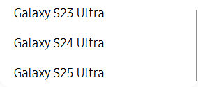
Features-Design Compare (3/3)
1
2
3
4
5
6
7
8
No. |  | Tagging Source
1 |  | Compare Galaxy Z Fold3 Size
 | AA | data-omni-type="microsite_contentinter" data-omni="galaxy-z-fold7:features:design^size-compare:slct-device:galaxy-z-fold3"
 | GA | ga-ca="content click" ga-ac="feature" ga-la="galaxy-z-fold7:features:design^size-compare:slct-device:galaxy-z-fold3"
2 |  | Compare Galaxy Z Fold4 Size
 | AA | data-omni-type="microsite_contentinter" data-omni="galaxy-z-fold7:features:design^size-compare:slct-device:galaxy-z-fold4"
 | GA | ga-ca="content click" ga-ac="feature" ga-la="galaxy-z-fold7:features:design^size-compare:slct-device:galaxy-z-fold4"
3 |  | Compare Galaxy Z Fold5 Size
 | AA | data-omni-type="microsite_contentinter" data-omni="galaxy-z-fold7:features:design^size-compare:slct-device:galaxy-z-fold5"
 | GA | ga-ca="content click" ga-ac="feature" ga-la="galaxy-z-fold7:features:design^size-compare:slct-device:galaxy-z-fold5"
4 |  | Compare Galaxy Z Fold6 Size
 | AA | data-omni-type="microsite_contentinter" data-omni="galaxy-z-fold7:features:design^size-compare:slct-device:galaxy-z-fold6"
 | GA | ga-ca="content click" ga-ac="feature" ga-la="galaxy-z-fold7:features:design^size-compare:slct-device:galaxy-z-fold6"
5 |  | Compare Galaxy S22 Ultra Size
 | AA | data-omni-type="microsite_contentinter" data-omni="galaxy-z-fold7:features:design^size-compare:slct-device:galaxy-s22-ultra"
 | GA | ga-ca="content click" ga-ac="feature" ga-la="galaxy-z-fold7:features:design^size-compare:slct-device:galaxy-s22-ultra"
6 |  | Compare Galaxy S23 Ultra Size
 | AA | data-omni-type="microsite_contentinter" data-omni="galaxy-z-fold7:features:design^size-compare:slct-device:galaxy-s23-ultra"
 | GA | ga-ca="content click" ga-ac="feature" ga-la="galaxy-z-fold7:features:design^size-compare:slct-device:galaxy-s23-ultra"
7 |  | Compare Galaxy S24 Ultra Size
 | AA | data-omni-type="microsite_contentinter" data-omni="galaxy-z-fold7:features:design^size-compare:slct-device:galaxy-s24-ultra"
 | GA | ga-ca="content click" ga-ac="feature" ga-la="galaxy-z-fold7:features:design^size-compare:slct-device:galaxy-s24-ultra"
8 |  | Compare Galaxy S25 Ultra Size
 | AA | data-omni-type="microsite_contentinter" data-omni="galaxy-z-fold7:features:design^size-compare:slct-device:galaxy-s25-ultra"
 | GA | ga-ca="content click" ga-ac="feature" ga-la="galaxy-z-fold7:features:design^size-compare:slct-device:galaxy-s25-ultra"

Slide 22

Features-High Resolution (Mobile Only)
1
No. |  | Tagging Source
1 |  | Click to See more
 | AA | data-omni-type="microsite_contentinter" data-omni="galaxy-z-fold7:features:camera^high-resolution:acdn-open:see-more"
 | GA | ga-ca="indication" ga-ac="accordion" ga-la="galaxy-z-fold7:features:camera^high-resolution:acdn-open:see-more"

Slide 23
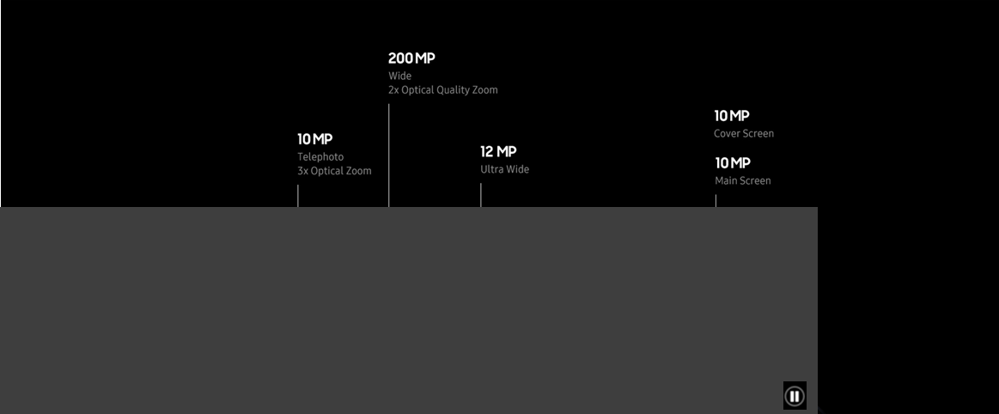
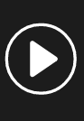
Features-HW Spec
1
2
No. |  | Tagging Source
1 |  | Click to Play
 | AA | data-omni-type="microsite_contentinter" data-omni="galaxy-z-fold7:features:camera^hw-specs:movi-play:main-movie"
 | GA | ga-ca="content click" ga-ac="feature" ga-la="galaxy-z-fold7:features:camera^hw-specs:movi-play:main-movie"
2 |  | Click to Pause
 | AA | data-omni-type="microsite_contentinter" data-omni="galaxy-z-fold7:features:camera^hw-specs:movi-pause:main-movie"
 | GA | ga-ca="content click" ga-ac="feature" ga-la="galaxy-z-fold7:features:camera^hw-specs:movi-pause:main-movie"

Slide 24
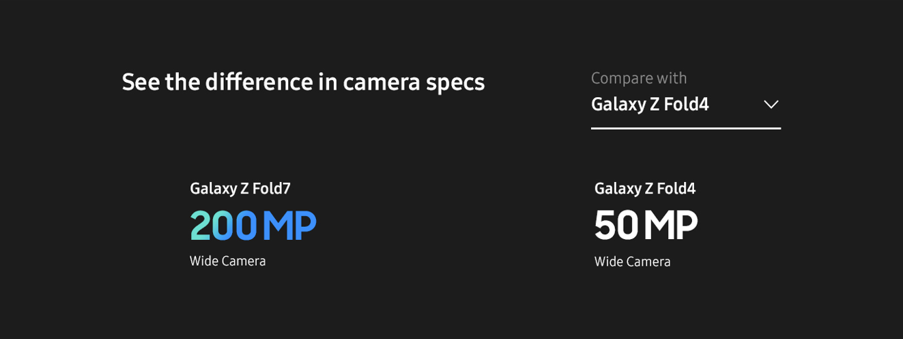
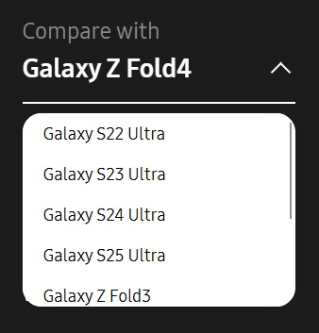
Features-Camera Compare (1/2)
1
2
No. |  | Tagging Source
1 |  | Open Compare List
 | AA | data-omni-type="microsite_contentinter" data-omni="galaxy-z-fold7:features:camera^camera-compare:slct-device-open:pre"
 | GA | ga-ca="content click" ga-ac="feature" ga-la="galaxy-z-fold7:features:camera^camera-compare:slct-device-open:pre"
2 |  | Close Compare List
 | AA | data-omni-type="microsite_contentinter" data-omni="galaxy-z-fold7:features:camera^camera-compare:slct-device-close:pre"
 | GA | ga-ca="content click" ga-ac="feature" ga-la="galaxy-z-fold7:features:camera^camera-compare:slct-device-close:pre"

Slide 25
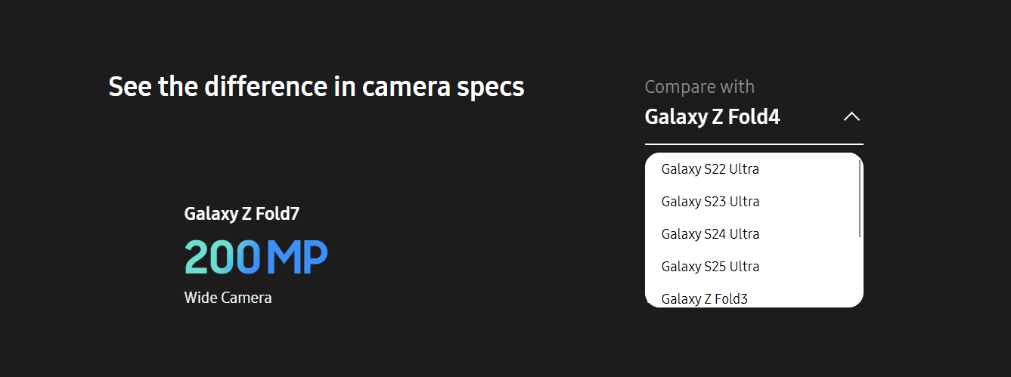
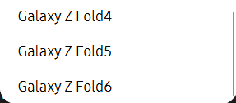
Features-Camera Compare (2/2)
1
2
3
4
5
6
7
8
No. |  | Tagging Source
1 |  | Compare Galaxy S22 Ultra
 | AA | data-omni-type="microsite_contentinter" data-omni="galaxy-z-fold7:features:camera^camera-compare:slct-device:galaxy-s22-ultra"
 | GA | ga-ca="content click" ga-ac="feature" ga-la="galaxy-z-fold7:features:camera^camera-compare:slct-device:galaxy-s22-ultra"
2 |  | Compare Galaxy S23 Ultra
 | AA | data-omni-type="microsite_contentinter" data-omni="galaxy-z-fold7:features:camera^camera-compare:slct-device:galaxy-s23-ultra"
 | GA | ga-ca="content click" ga-ac="feature" ga-la="galaxy-z-fold7:features:camera^camera-compare:slct-device:galaxy-s23-ultra"
3 |  | Compare Galaxy S24 Ultra
 | AA | data-omni-type="microsite_contentinter" data-omni="galaxy-z-fold7:features:camera^camera-compare:slct-device:galaxy-s24-ultra"
 | GA | ga-ca="content click" ga-ac="feature" ga-la="galaxy-z-fold7:features:camera^camera-compare:slct-device:galaxy-s24-ultra"
4 |  | Compare Galaxy S25 Ultra
 | AA | data-omni-type="microsite_contentinter" data-omni="galaxy-z-fold7:features:camera^camera-compare:slct-device:galaxy-s25-ultra"
 | GA | ga-ca="content click" ga-ac="feature" ga-la="galaxy-z-fold7:features:camera^camera-compare:slct-device:galaxy-s25-ultra"
5 |  | Compare Galaxy Z Fold3
 | AA | data-omni-type="microsite_contentinter" data-omni="galaxy-z-fold7:features:camera^camera-compare:slct-device:galaxy-z-fold3"
 | GA | ga-ca="content click" ga-ac="feature" ga-la="galaxy-z-fold7:features:camera^camera-compare:slct-device:galaxy-z-fold3"
6 |  | Compare Galaxy Z Fold4
 | AA | data-omni-type="microsite_contentinter" data-omni="galaxy-z-fold7:features:camera^camera-compare:slct-device:galaxy-z-fold4"
 | GA | ga-ca="content click" ga-ac="feature" ga-la="galaxy-z-fold7:features:camera^camera-compare:slct-device:galaxy-z-fold4"
7 |  | Compare Galaxy Z Fold5
 | AA | data-omni-type="microsite_contentinter" data-omni="galaxy-z-fold7:features:camera^camera-compare:slct-device:galaxy-z-fold5"
 | GA | ga-ca="content click" ga-ac="feature" ga-la="galaxy-z-fold7:features:camera^camera-compare:slct-device:galaxy-z-fold5"
8 |  | Compare Galaxy Z Fold6
 | AA | data-omni-type="microsite_contentinter" data-omni="galaxy-z-fold7:features:camera^camera-compare:slct-device:galaxy-z-fold6"
 | GA | ga-ca="content click" ga-ac="feature" ga-la="galaxy-z-fold7:features:camera^camera-compare:slct-device:galaxy-z-fold6"

Slide 26
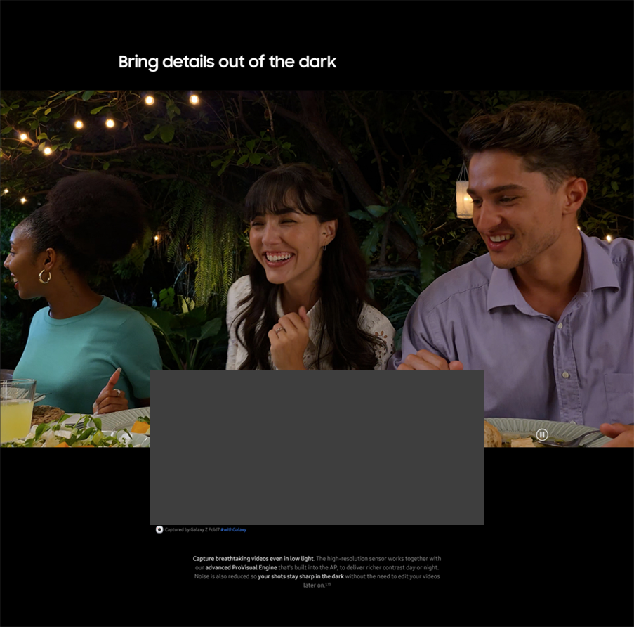

Features-Nightography
1
2
No. |  | Tagging Source
1 |  | Click to Play
 | AA | data-omni-type="microsite_contentinter" data-omni="galaxy-z-fold7:features:camera^nightography-video:movi-play:main-movie"
 | GA | ga-ca="content click" ga-ac="feature" ga-la="galaxy-z-fold7:features:camera^nightography-video:movi-play:main-movie"
2 |  | Click to Pause
 | AA | data-omni-type="microsite_contentinter" data-omni="galaxy-z-fold7:features:camera^nightography-video:movi-pause:main-movie"
 | GA | ga-ca="content click" ga-ac="feature" ga-la="galaxy-z-fold7:features:camera^nightography-video:movi-pause:main-movie"

Slide 27
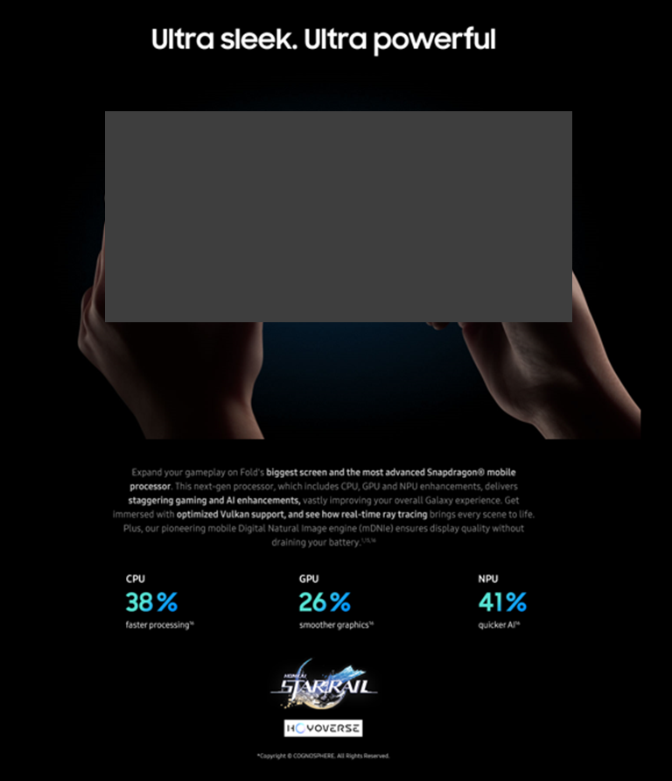


Features-AP
1
2
No. |  | Tagging Source
1 |  | Click to Play
 | AA | data-omni-type="microsite_contentinter" data-omni="galaxy-z-fold7:features:performance^ap:movi-play:main-movie"
 | GA | ga-ca="content click" ga-ac="feature" ga-la="galaxy-z-fold7:features:performance^ap:movi-play:main-movie"
2 |  | Click to Pause
 | AA | data-omni-type="microsite_contentinter" data-omni="galaxy-z-fold7:features:performance^ap:movi-pause:main-movie"
 | GA | ga-ca="content click" ga-ac="feature" ga-la="galaxy-z-fold7:features:performance^ap:movi-pause:main-movie"

Slide 28
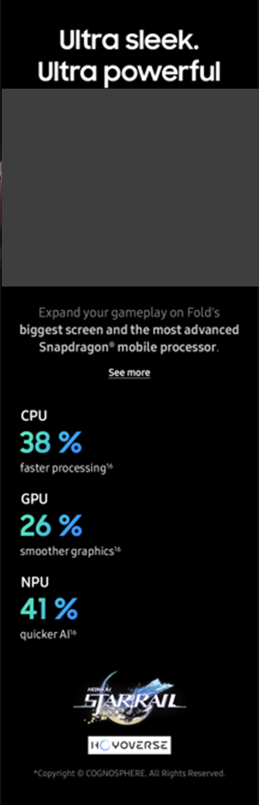
Features-AP (Mobile Only)
1
No. |  | Tagging Source
1 |  | Click to See more
 | AA | data-omni-type="microsite_contentinter" data-omni="galaxy-z-fold7:features:performance^ap:acdn-open:see-more"
 | GA | ga-ca="indication" ga-ac="accordion" ga-la="galaxy-z-fold7:features:performance^ap:acdn-open:see-more"

Slide 29
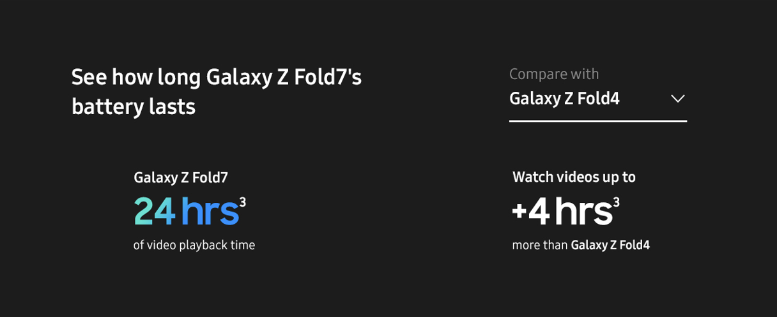
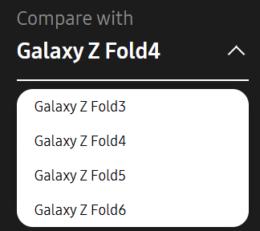
Features-Battery Compare (1/2)
1
2
No. |  | Tagging Source
1 |  | Open Compare List
 | AA | data-omni-type="microsite_contentinter" data-omni="galaxy-z-fold7:features:performance^battery-compare:slct-device-open:pre"
 | GA | ga-ca="content click" ga-ac="feature" ga-la="galaxy-z-fold7:features:performance^battery-compare:slct-device-open:pre"
2 |  | Close Compare List
 | AA | data-omni-type="microsite_contentinter" data-omni="galaxy-z-fold7:features:performance^battery-compare:slct-device-close:pre"
 | GA | ga-ca="content click" ga-ac="feature" ga-la="galaxy-z-fold7:features:performance^battery-compare:slct-device-close:pre"

Slide 30
Features-Battery Compare (2/2)
1
2
3
4
No. |  | Tagging Source
1 |  | Compare Galaxy Z Fold3 Battery
 | AA | data-omni-type="microsite_contentinter" data-omni="galaxy-z-fold7:features:performance^battery-compare:slct-device:galaxy-z-fold3"
 | GA | ga-ca="content click" ga-ac="feature" ga-la="galaxy-z-fold7:features:performance^battery-compare:slct-device:galaxy-z-fold3"
2 |  | Compare Galaxy Z Fold4 Battery
 | AA | data-omni-type="microsite_contentinter" data-omni="galaxy-z-fold7:features:performance^battery-compare:slct-device:galaxy-z-fold4"
 | GA | ga-ca="content click" ga-ac="feature" ga-la="galaxy-z-fold7:features:performance^battery-compare:slct-device:galaxy-z-fold4"
3 |  | Compare Galaxy Z Fold5 Battery
 | AA | data-omni-type="microsite_contentinter" data-omni="galaxy-z-fold7:features:performance^battery-compare:slct-device:galaxy-z-fold5"
 | GA | ga-ca="content click" ga-ac="feature" ga-la="galaxy-z-fold7:features:performance^battery-compare:slct-device:galaxy-z-fold5"
4 |  | Compare Galaxy Z Fold6 Battery
 | AA | data-omni-type="microsite_contentinter" data-omni="galaxy-z-fold7:features:performance^battery-compare:slct-device:galaxy-z-fold6"
 | GA | ga-ca="content click" ga-ac="feature" ga-la="galaxy-z-fold7:features:performance^battery-compare:slct-device:galaxy-z-fold6"

Slide 31
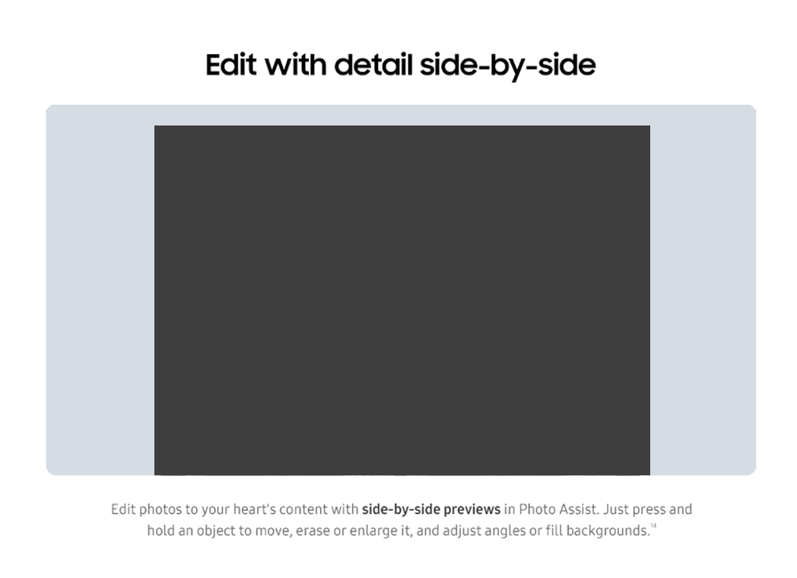


Features-Photo Assist
1
2
No. |  | Tagging Source
1 |  | Click to Play
 | AA | data-omni-type="microsite_contentinter" data-omni="galaxy-z-fold7:features:ai^photo-assist:movi-play:main-movie"
 | GA | ga-ca="content click" ga-ac="feature" ga-la="galaxy-z-fold7:features:ai^photo-assist:movi-play:main-movie"
2 |  | Click to Pause
 | AA | data-omni-type="microsite_contentinter" data-omni="galaxy-z-fold7:features:ai^photo-assist:movi-pause:main-movie"
 | GA | ga-ca="content click" ga-ac="feature" ga-la="galaxy-z-fold7:features:ai^photo-assist:movi-pause:main-movie"

Slide 32
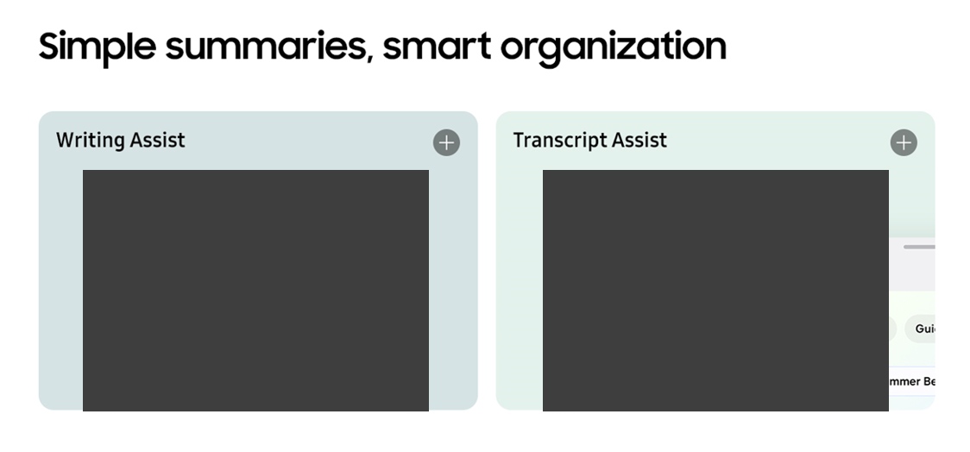
Features-AI Experience
1
1
No. |  | Tagging Source
1 |  | Click to Open Pop up
 | AA | data-omni-type="microsite_contentinter" data-omni="galaxy-z-fold7:features:ai^galaxy-ai-experience^writing-assist:lypu-open:writing-assist"
 | GA | ga-ca="content click" ga-ac="feature" ga-la="galaxy-z-fold7:features:ai^galaxy-ai-experience^writing-assist:lypu-open:writing-assist"
2 |  | Click to Open Pop up
 |  | data-omni-type="microsite_contentinter" data-omni="galaxy-z-fold7:features:ai^galaxy-ai-experience^transcript-assist:lypu-open:transcript-assist"
 |  | ga-ca="content click" ga-ac="feature" ga-la="galaxy-z-fold7:features:ai^galaxy-ai-experience^transcript-assist:lypu-open:transcript-assist"

Slide 33
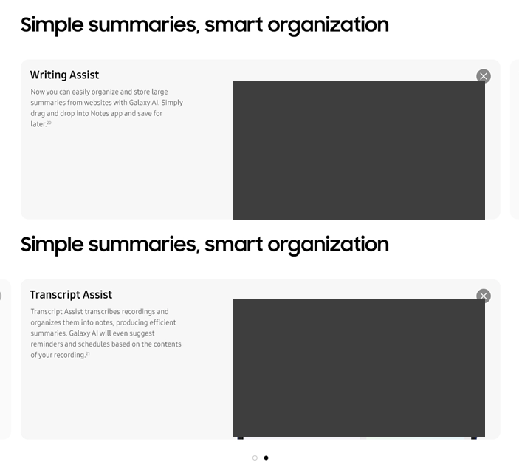
Features-AI Experience
1
2
3
4
No. |  | Tagging Source
1 |  | Click to Close Pop up
 | AA | data-omni-type="microsite_contentinter" data-omni="galaxy-z-fold7:features:ai^galaxy-ai-experience^writing-assist:lypu-close:writing-assist"
 | GA | ga-ca="content click" ga-ac="feature" ga-la="galaxy-z-fold7:features:ai^galaxy-ai-experience^writing-assist:lypu-close:writing-assist"
2 |  | Click to Close Pop up
 | AA | data-omni-type="microsite_contentinter" data-omni="galaxy-z-fold7:features:ai^galaxy-ai-experience^transcript-assist:lypu-close:transcript-assist"
 | GA | ga-ca="content click" ga-ac="feature" ga-la="galaxy-z-fold7:features:ai^galaxy-ai-experience^transcript-assist:lypu-close:transcript-assist"
3 |  | Click to Indicator 1
 | AA | data-omni-type="microsite_contentinter” data-omni="galaxy-z-fold7:features:ai^galaxy-ai-experience:index:writing-assist"
 | GA | ga-ca="gallery" ga-ac="feature gallery" ga-la="galaxy-z-fold7:features:ai^galaxy-ai-experience:index:writing-assist"
4 |  | Click to Indicator 2
 | AA | data-omni-type="microsite_contentinter” data-omni="galaxy-z-fold7:features:ai^galaxy-ai-experience:index:transcript-assist"
 | GA | ga-ca="gallery" ga-ac="feature gallery" ga-la="galaxy-z-fold7:features:ai^galaxy-ai-experience:index:transcript-assist"

Slide 34
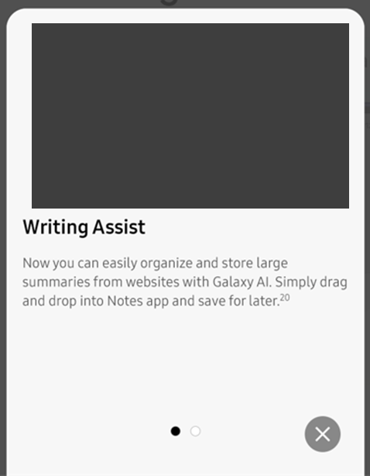
Features-Protactive Suggestion (Mobile Only)
1
2
3
No. |  | Tagging Source
1 |  | Click to Carousel
 | AA | data-omni-type="microsite_contentinter” data-omni="galaxy-z-fold7:features:ai^galaxy-ai-experience:index:writing-assist"
 | GA | ga-ca="gallery" ga-ac="feature gallery" ga-la="galaxy-z-fold7:features:ai^galaxy-ai-experience:index:writing-assist"
2 |  | Click to Carouse2
 | AA | data-omni-type="microsite_contentinter” data-omni="galaxy-z-fold7:features:ai^galaxy-ai-experience:index:transcript-assist"
 | GA | ga-ca="gallery" ga-ac="feature gallery" ga-la="galaxy-z-fold7:features:ai^galaxy-ai-experience:index:transcript-assist"
3 |  | Click to Close Pop up
 | AA | data-omni-type="microsite_contentinter" data-omni="galaxy-z-fold7:features:ai^galaxy-ai-experience-popup:lypu-close:close"
 | GA | ga-ca="content click" ga-ac="feature" ga-la="galaxy-z-fold7:features:ai^galaxy-ai-experience-popup:lypu-close:close"

Slide 35
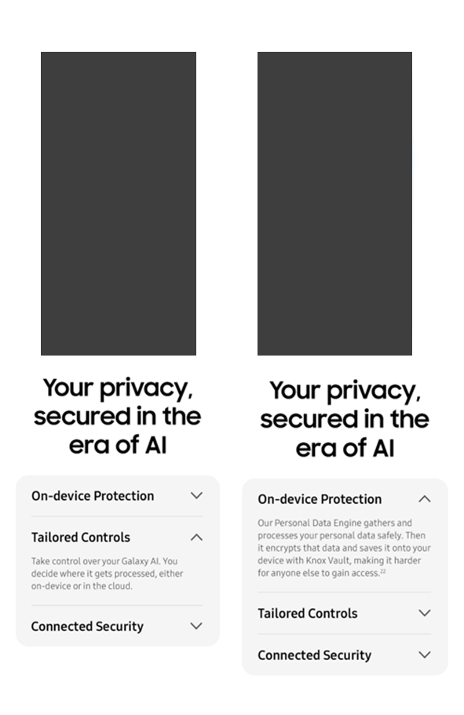
Features-Privacy (Mobile Only)
1
2
3
4
5
6
No. |  | Tagging Source
1 |  | Click to open On-device Protection
 | AA | data-omni-type="microsite_contentinter" data-omni="galaxy-z-fold7:features:privacy:acdn-open:on-device-protection"
 | GA | ga-ca="indication" ga-ac="accordion" ga-la="galaxy-z-fold7:features:privacy:acdn-open:on-device-protection"
2 |  | Click to close On-device Protection
 | AA | data-omni-type="microsite_contentinter" data-omni="galaxy-z-fold7:features:privacy:acdn-close:on-device-protection"
 | GA | ga-ca="indication" ga-ac="accordion" ga-la="galaxy-z-fold7:features:privacy:acdn-close:on-device-protection"
3 |  | Click to open Tailored Controls
 | AA | data-omni-type="microsite_contentinter" data-omni="galaxy-z-fold7:features:privacy:acdn-open:tailored-controls"
 | GA | ga-ca="indication" ga-ac="accordion" ga-la="galaxy-z-fold7:features:privacy:acdn-open:tailored-controls"
4 |  | Click to close Tailored Controls
 | AA | data-omni-type="microsite_contentinter" data-omni="galaxy-z-fold7:features:privacy:acdn-close:tailored-controls"
 | GA | ga-ca="indication" ga-ac="accordion" ga-la="galaxy-z-fold7:features:privacy:acdn-close:tailored-controls"
5 |  | Click to open Connected Security
 | AA | data-omni-type="microsite_contentinter" data-omni="galaxy-z-fold7:features:privacy:acdn-open:connected-security"
 | GA | ga-ca="indication" ga-ac="accordion" ga-la="galaxy-z-fold7:features:privacy:acdn-open:connected-security"
6 |  | Click to close Connected Security
 | AA | data-omni-type="microsite_contentinter" data-omni="galaxy-z-fold7:features:privacy:acdn-close:connected-security"
 | GA | ga-ca="indication" ga-ac="accordion" ga-la="galaxy-z-fold7:features:privacy:acdn-close:connected-security"

Slide 36
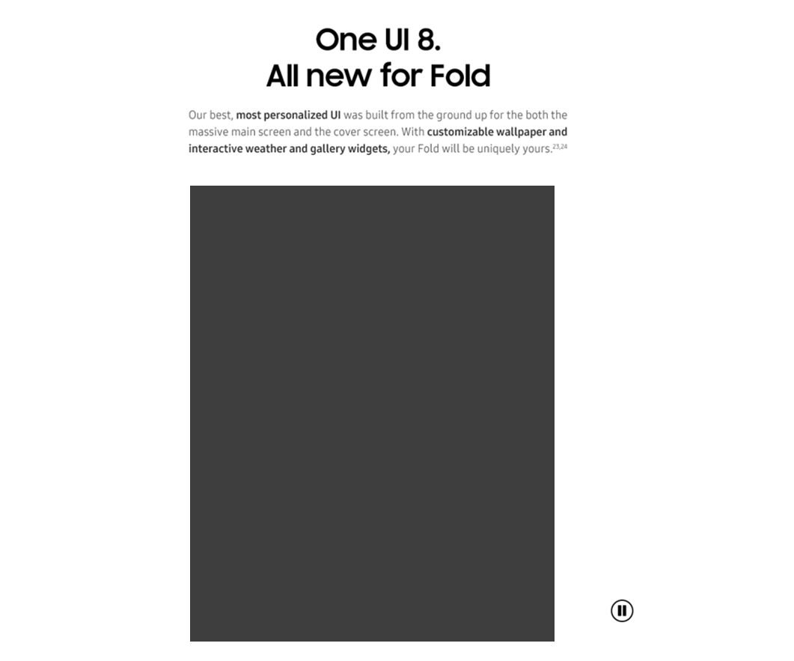

Features-One UI
1
2
No. |  | Tagging Source
1 |  | Click to Play
 | AA | data-omni-type="microsite_contentinter" data-omni="galaxy-z-fold7:features:galaxy-experience^one-ui:movi-play:main-movie"
 | GA | ga-ca="content click" ga-ac="feature" ga-la="galaxy-z-fold7:features:galaxy-experience^one-ui:movi-play:main-movie"
2 |  | Click to Pause
 | AA | data-omni-type="microsite_contentinter" data-omni="galaxy-z-fold7:features:galaxy-experience^one-ui:movi-pause:main-movie"
 | GA | ga-ca="content click" ga-ac="feature" ga-la="galaxy-z-fold7:features:galaxy-experience^one-ui:movi-pause:main-movie"

Slide 37

Features-Bar Type
1
2
No. |  | Tagging Source
1 |  | Click to Play
 | AA | data-omni-type="microsite_contentinter" data-omni="galaxy-z-fold7:features:galaxy-experience^bar-type:movi-play:main-movie"
 | GA | ga-ca="content click" ga-ac="feature" ga-la="galaxy-z-fold7:features:galaxy-experience^bar-type:movi-play:main-movie"
2 |  | Click to Pause
 | AA | data-omni-type="microsite_contentinter" data-omni="galaxy-z-fold7:features:galaxy-experience^bar-type:movi-pause:main-movie"
 | GA | ga-ca="content click" ga-ac="feature" ga-la="galaxy-z-fold7:features:galaxy-experience^bar-type:movi-pause:main-movie"

Slide 38
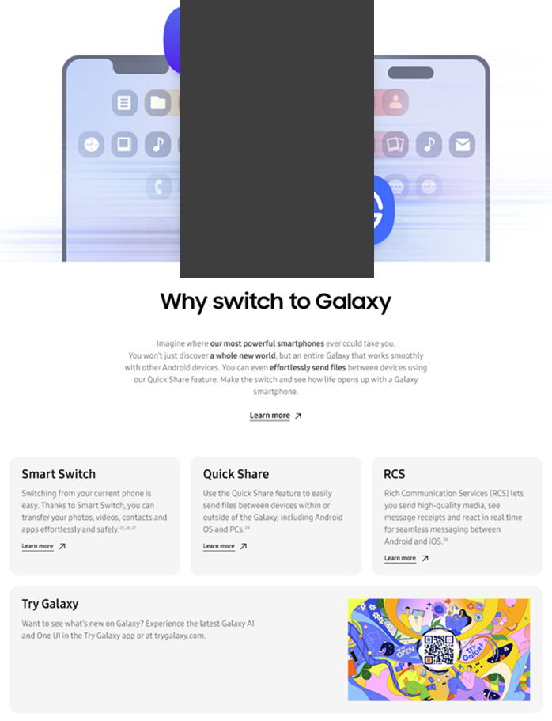
Features-Switch to Galaxy
1
2
3
3
No. |  | Tagging Source
1 |  | Click to go Switch to Galaxy Page
 | AA | data-omni-type="microsite_contentinter" data-omni="galaxy-z-fold7:features:switch-to-galaxy:link-page:apps^switch-to-galaxy"
 | GA | ga-ca="content click" ga-ac="feature" ga-la="galaxy-z-fold7:features:switch-to-galaxy:link-page:apps^switch-to-galaxy"
2 |  | Click to go Smart Switch Page
 | AA | data-omni-type="microsite_contentinter" data-omni="galaxy-z-fold7:features:switch-to-galaxy^smart-switch:link-page:apps^smart-switch"
 | GA | ga-ca="content click" ga-ac="feature" ga-la="galaxy-z-fold7:features:switch-to-galaxy^smart-switch:link-page:apps^smart-switch"
3 |  | Click to go Quick Share Page
 | AA | data-omni-type="microsite_contentinter" data-omni="galaxy-z-fold7:features:switch-to-galaxy^quick-share:link-page:apps^quick-share"
 | GA | ga-ca="content click" ga-ac="feature" ga-la="galaxy-z-fold7:features:switch-to-galaxy^quick-share:link-page:apps^quick-share"
4 |  | Click to go RCS Page
 | AA | data-omni-type="microsite_contentinter" data-omni="galaxy-z-fold7:features:switch-to-galaxy^rich-communication-service:link-page:rich-communication-service"
 | GA | ga-ca="content click" ga-ac="feature" ga-la="galaxy-z-fold7:features:switch-to-galaxy^rich-communication-service:link-page:rich-communication-service"

Slide 39
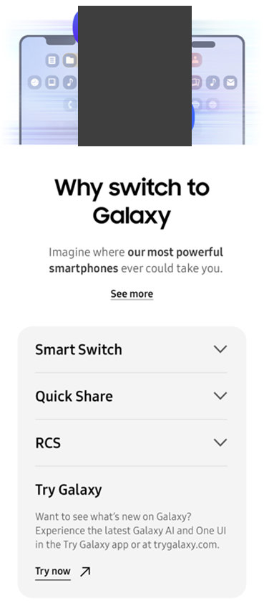

Features-Switch to Galaxy (Mobile Only)
1
2
3
4
5
6
7
8
9
10
No. |  | Tagging Source
1 |  | Click to See more
 | AA | data-omni-type="microsite_contentinter" data-omni="galaxy-z-fold7:features:switch-to-galaxy:acdn-open:see-more"
 | GA | ga-ca="indication" ga-ac="accordion" ga-la="galaxy-z-fold7:features:switch-to-galaxy:acdn-open:see-more"
2 |  | Click to open Smart Switch
 | AA | data-omni-type="microsite_contentinter" data-omni="galaxy-z-fold7:features:switch-to-galaxy:acdn-open:smart-switch"
 | GA | ga-ca="indication" ga-ac="accordion" ga-la="galaxy-z-fold7:features:switch-to-galaxy:acdn-open:smart-switch"
3 |  | Click to close Smart Switch
 | AA | data-omni-type="microsite_contentinter" data-omni="galaxy-z-fold7:features:switch-to-galaxy:acdn-close:smart-switch"
 | GA | ga-ca="indication" ga-ac="accordion" ga-la="galaxy-z-fold7:features:switch-to-galaxy:acdn-close:smart-switch"
4 |  | Click to open Quick share
 | AA | data-omni-type="microsite_contentinter" data-omni="galaxy-z-fold7:features:switch-to-galaxy:acdn-open:quick-share"
 | GA | ga-ca="indication" ga-ac="accordion" ga-la="galaxy-z-fold7:features:switch-to-galaxy:acdn-open:quick-share"
5 |  | Click to close Quick share
 | AA | data-omni-type="microsite_contentinter" data-omni="galaxy-z-fold7:features:switch-to-galaxy:acdn-close:quick-share"
 | GA | ga-ca="indication" ga-ac="accordion" ga-la="galaxy-z-fold7:features:switch-to-galaxy:acdn-close:quick-share"
6 |  | Click to open RCS
 | AA | data-omni-type="microsite_contentinter" data-omni="galaxy-z-fold7:features:switch-to-galaxy:acdn-open:rich-communication-service"
 | GA | ga-ca="indication" ga-ac="accordion" ga-la="galaxy-z-fold7:features:switch-to-galaxy:acdn-open:rich-communication-service"
7 |  | Click to close RCS
 | AA | data-omni-type="microsite_contentinter" data-omni="galaxy-z-fold7:features:switch-to-galaxy:acdn-close:rich-communication-service"
 | GA | ga-ca="indication" ga-ac="accordion" ga-la="galaxy-z-fold7:features:switch-to-galaxy:acdn-close:rich-communication-service"

Slide 40
Features-Switch to Galaxy (Mobile Only)
No. |  | Tagging Source
8 |  | Click to open Try Galaxy
 | AA | data-omni-type="microsite_contentinter" data-omni="galaxy-z-fold7:features:switch-to-galaxy:acdn-open:try-galaxy"
 | GA | ga-ca="indication" ga-ac="accordion" ga-la="galaxy-z-fold7:features:switch-to-galaxy:acdn-open:try-galaxy"
9 |  | Click to close Try Galaxy
 | AA | data-omni-type="microsite_contentinter" data-omni="galaxy-z-fold7:features:switch-to-galaxy:acdn-close:try-galaxy"
 | GA | ga-ca="indication" ga-ac="accordion" ga-la="galaxy-z-fold7:features:switch-to-galaxy:acdn-close:try-galaxy"
10 |  | Click to go Quick Share Page
 | AA | data-omni-type="microsite_contentinter" data-omni="galaxy-z-fold7:features:switch-to-galaxy^try-now:link-page:apps^try-galaxy"
 | GA | ga-ca="content click" ga-ac="feature" ga-la="galaxy-z-fold7:features:switch-to-galaxy^try-now:link-page:apps^try-galaxy"

Slide 41
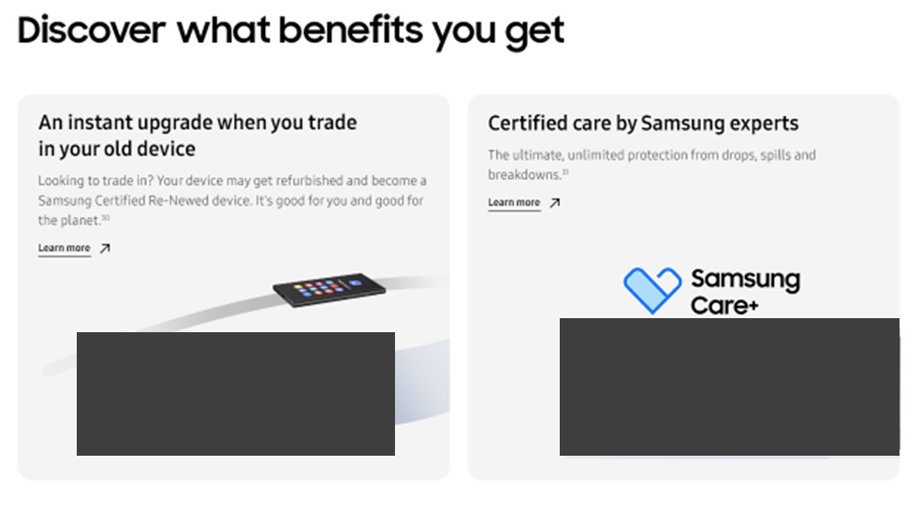
Features-Benefits
2
1
No. |  | Tagging Source
1 |  | Click to go Trade in Page
 | AA | data-omni-type="microsite_contentinter" data-omni="galaxy-z-fold7:features:benefits:link-page:trade-in"
 | GA | ga-ca="content click" ga-ac="feature" ga-la="galaxy-z-fold7:features:benefits:link-page:trade-in"
2 |  | Click to go Samsung Care+ Page
 | AA | data-omni-type="microsite_contentinter" data-omni="galaxy-z-fold7:features:benefits:link-page:apps^samsung-care-plus"
 | GA | ga-ca="content click" ga-ac="feature" ga-la="galaxy-z-fold7:features:benefits:link-page:apps^samsung-care-plus"

Slide 42
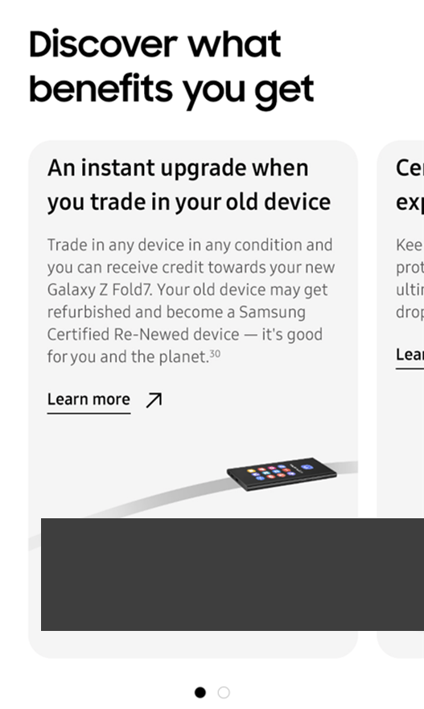
Features – Benefits (MO Only)
1
2
No. |  | Tagging Source
1 |  | Click to Indicator 1
 | AA | data-omni-type="microsite_contentinter" data-omni="galaxy-z-fold7:features:benefits:index:1"
 | GA | ga-ca="gallery" ga-ac="feature gallery" ga-la="galaxy-z-fold7:features:benefits:index:1"
2 |  | Click to Indicator 2
 | AA | data-omni-type="microsite_contentinter" data-omni="galaxy-z-fold7:features:benefits:index:2"
 | GA | ga-ca="gallery" ga-ac="feature gallery" ga-la="galaxy-z-fold7:features:benefits:index:2"

Slide 43
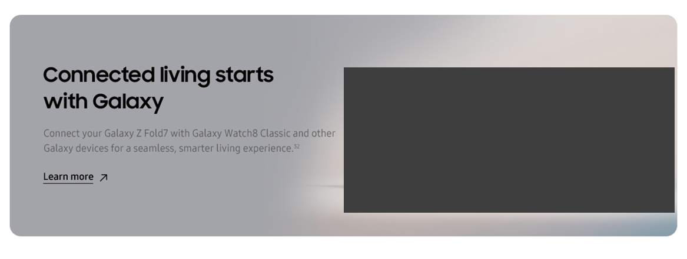
Features-Eco System
1
No. |  | Tagging Source
1 |  | Click to go Watch8 Classic page
 | AA | data-omni-type="microsite_contentinter" data-omni="galaxy-z-fold7:features:ecosystem:link-page:galaxy-watch8-classic"
 | GA | ga-ca="content click" ga-ac="feature" ga-la="galaxy-z-fold7:features:ecosystem:link-page:galaxy-watch8-classic"

Slide 44
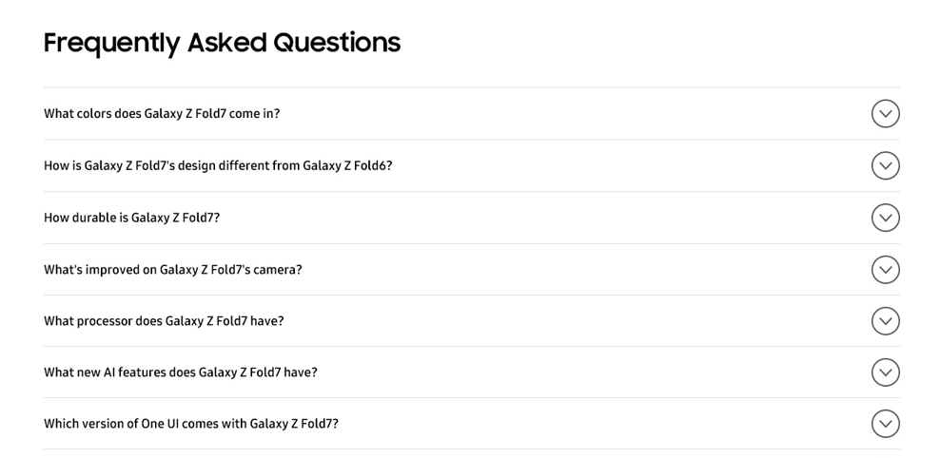
Features-FAQ (1/2)
1
2
3
4
5
6
7
No. |  | Tagging Source
1 |  | Click to open Colors FAQ
 | AA | data-omni-type="microsite_contentinter" data-omni="galaxy-z-fold7:features:faq:acdn-open:colors"
 | GA | ga-ca="indication" ga-ac="accordion" ga-la="galaxy-z-fold7:features:faq:acdn-open:colors"
2 |  | Click to open Design FAQ
 | AA | data-omni-type="microsite_contentinter" data-omni="galaxy-z-fold7:features:faq:acdn-open:design^compare"
 | GA | ga-ca="indication" ga-ac="accordion" ga-la="galaxy-z-fold7:features:faq:acdn-open:design^compare"
3 |  | Click to open Durability FAQ
 | AA | data-omni-type="microsite_contentinter" data-omni="galaxy-z-fold7:features:faq:acdn-open:durability"
 | GA | ga-ca="indication" ga-ac="accordion" ga-la="galaxy-z-fold7:features:faq:acdn-open:durability"
4 |  | Click to open Camera FAQ
 | AA | data-omni-type="microsite_contentinter" data-omni="galaxy-z-fold7:features:faq:acdn-open:camera"
 | GA | ga-ca="indication" ga-ac="accordion" ga-la="galaxy-z-fold7:features:faq:acdn-open:camera"
5 |  | Click to open Performance FAQ
 | AA | data-omni-type="microsite_contentinter" data-omni="galaxy-z-fold7:features:faq:acdn-open:performance"
 | GA | ga-ca="indication" ga-ac="accordion" ga-la="galaxy-z-fold7:features:faq:acdn-open:performance"
6 |  | Click to open AI FAQ
 | AA | data-omni-type="microsite_contentinter" data-omni="galaxy-z-fold7:features:faq:acdn-open:ai"
 | GA | ga-ca="indication" ga-ac="accordion" ga-la="galaxy-z-fold7:features:faq:acdn-open:ai"
7 |  | Click to open One UI FAQ
 | AA | data-omni-type="microsite_contentinter" data-omni="galaxy-z-fold7:features:faq:acdn-open:one-ui"
 | GA | ga-ca="indication" ga-ac="accordion" ga-la="galaxy-z-fold7:features:faq:acdn-open:one-ui"

Slide 45
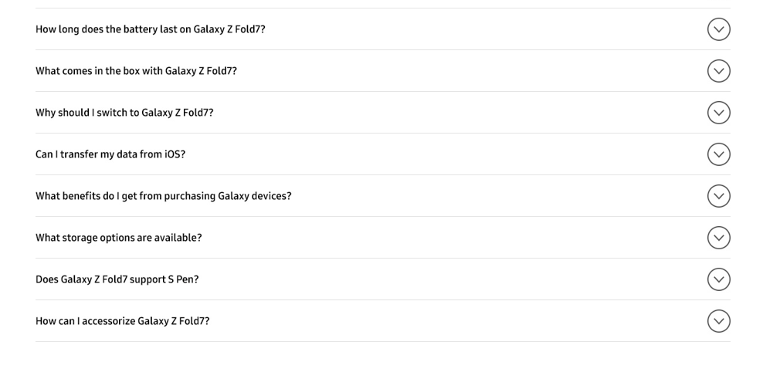
Features-FAQ (2/2)
8
9
10
11
12
13
14
15
No. |  | Tagging Source
8 |  | Click to open Battery FAQ
 | AA | data-omni-type="microsite_contentinter" data-omni="galaxy-z-fold7:features:faq:acdn-open:battery"
 | GA | ga-ca="indication" ga-ac="accordion" ga-la="galaxy-z-fold7:features:faq:acdn-open:battery"
9 |  | Click to open What's in the box FAQ
 | AA | data-omni-type="microsite_contentinter" data-omni="galaxy-z-fold7:features:faq:acdn-open:whats-in-the-box"
 | GA | ga-ca="indication" ga-ac="accordion" ga-la="galaxy-z-fold7:features:faq:acdn-open:whats-in-the-box"
10 |  | Click to open Switch to Galaxy FAQ
 | AA | data-omni-type="microsite_contentinter" data-omni="galaxy-z-fold7:features:faq:acdn-open:switch-to-galaxy"
 | GA | ga-ca="indication" ga-ac="accordion" ga-la="galaxy-z-fold7:features:faq:acdn-open:switch-to-galaxy"
11 |  | Click to open Smart Switch FAQ
 | AA | data-omni-type="microsite_contentinter" data-omni="galaxy-z-fold7:features:faq:acdn-open:smart-switch"
 | GA | ga-ca="indication" ga-ac="accordion" ga-la="galaxy-z-fold7:features:faq:acdn-open:smart-switch"
12 |  | Click to open Trade-In FAQ
 | AA | data-omni-type="microsite_contentinter" data-omni="galaxy-z-fold7:features:faq:acdn-open:trade-in"
 | GA | ga-ca="indication" ga-ac="accordion" ga-la="galaxy-z-fold7:features:faq:acdn-open:trade-in"
13 |  | Click to open Storage FAQ
 | AA | data-omni-type="microsite_contentinter" data-omni="galaxy-z-fold7:features:faq:acdn-open:storage"
 | GA | ga-ca="indication" ga-ac="accordion" ga-la="galaxy-z-fold7:features:faq:acdn-open:storage"
14 |  | Click to open S Pen FAQ
 | AA | data-omni-type="microsite_contentinter" data-omni="galaxy-z-fold7:features:faq:acdn-open:s-pen"
 | GA | ga-ca="indication" ga-ac="accordion" ga-la="galaxy-z-fold7:features:faq:acdn-open:s-pen"
15 |  | Click to open Accessories FAQ
 | AA | data-omni-type="microsite_contentinter" data-omni="galaxy-z-fold7:features:faq:acdn-open:accessories"
 | GA | ga-ca="indication" ga-ac="accordion" ga-la="galaxy-z-fold7:features:faq:acdn-open:accessories"

Slide 46
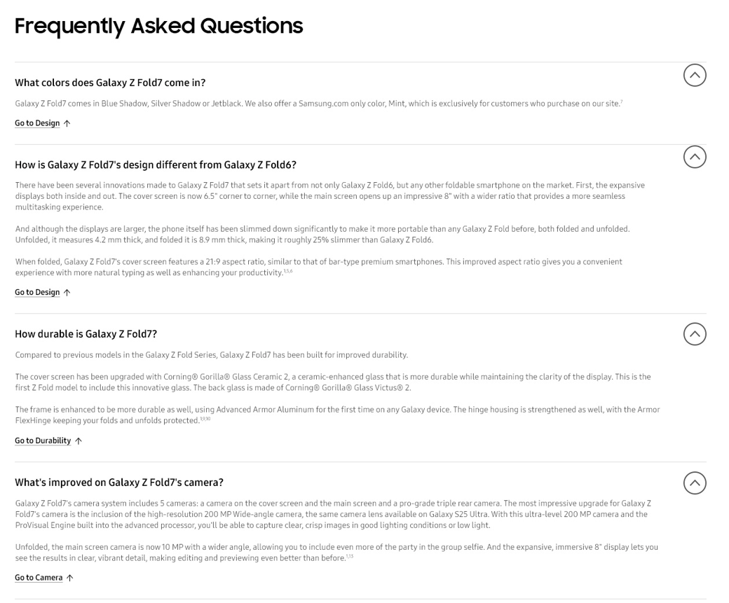
Features – FAQ (1/3)
1
2
3
4
No. |  | Tagging Source
1 |  | Click to go to Colors feature in Features page
 | AA | data-omni-type="microsite_contentinter" data-omni="galaxy-z-fold7:features:faq^colors:link-anchor:design^colors"
 | GA | ga-ca="content click" ga-ac="feature" ga-la="galaxy-z-fold7:features:faq^colors:link-anchor:design^colors"
2 |  | Click to go to Design Compare feature in Features page
 | AA | data-omni-type="microsite_contentinter" data-omni="galaxy-z-fold7:features:faq^design:link-anchor:design^compare"
 | GA | ga-ca="content click" ga-ac="feature" ga-la="galaxy-z-fold7:features:faq^design:link-anchor:design^compare"
3 |  | Click to go to Durability feature in Features page
 | AA | data-omni-type="microsite_contentinter" data-omni="galaxy-z-fold7:features:faq^durability:link-anchor:design^durability"
 | GA | ga-ca="content click" ga-ac="feature" ga-la="galaxy-z-fold7:features:faq^durability:link-anchor:design^durability"
4 |  | Click to go to High Resolution feature in Features page
 | AA | data-omni-type="microsite_contentinter" data-omni="galaxy-z-fold7:features:faq^camera:link-anchor:camera^high-resolution"
 | GA | ga-ca="content click" ga-ac="feature" ga-la="galaxy-z-fold7:features:faq^camera:link-anchor:camera^high-resolution"

Slide 47
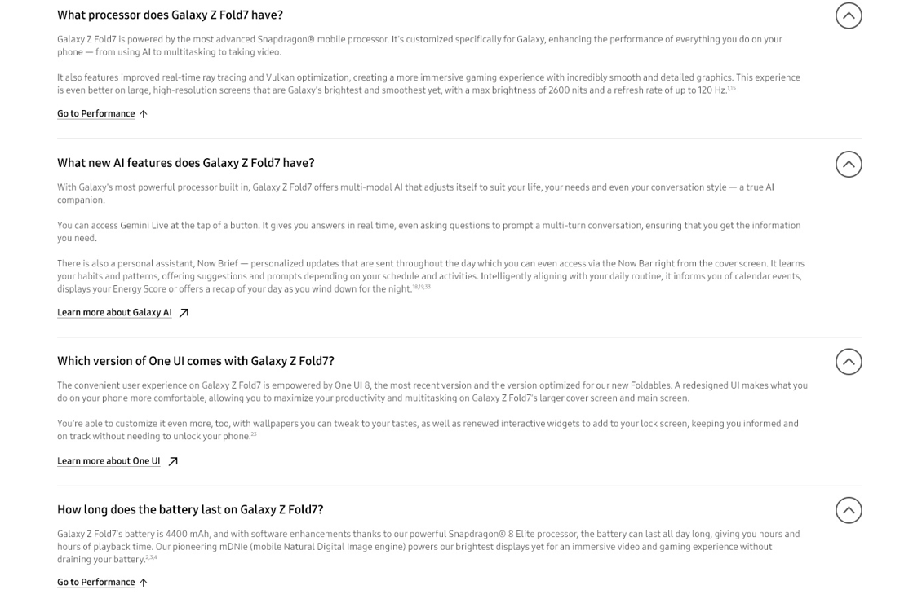
Features – FAQ (2/3)
5
6
7
8
No. |  | Tagging Source
5 |  | Click to go to Performance feature in Features page
 | AA | data-omni-type="microsite_contentinter" data-omni="galaxy-z-fold7:features:faq^performance:link-anchor:performance"
 | GA | ga-ca="content click" ga-ac="feature" ga-la="galaxy-z-fold7:features:faq^performance:link-anchor:performance"
6 |  | Click to go to Galaxy AI Page
 | AA | data-omni-type="microsite_contentinter" data-omni="galaxy-z-fold7:features:faq^ai:link-page:galaxy-ai"
 | GA | ga-ca="content click" ga-ac="feature" ga-la="galaxy-z-fold7:features:faq^ai:link-page:galaxy-ai"
7 |  | Click to go to One ui Page
 | AA | data-omni-type="microsite_contentinter" data-omni="galaxy-z-fold7:features:faq^one-ui:link-anchor:one-ui"
 | GA | ga-ca="content click" ga-ac="feature" ga-la="galaxy-z-fold7:features:faq^one-ui:link-anchor:one-ui"
8 |  | Click to go to Battery feature in Features page
 | AA | data-omni-type="microsite_contentinter" data-omni="galaxy-z-fold7:features:faq^battery:link-anchor:performance^"
 | GA | ga-ca="content click" ga-ac="feature" ga-la="galaxy-z-fold7:features:faq^battery:link-anchor:performance"

Slide 48
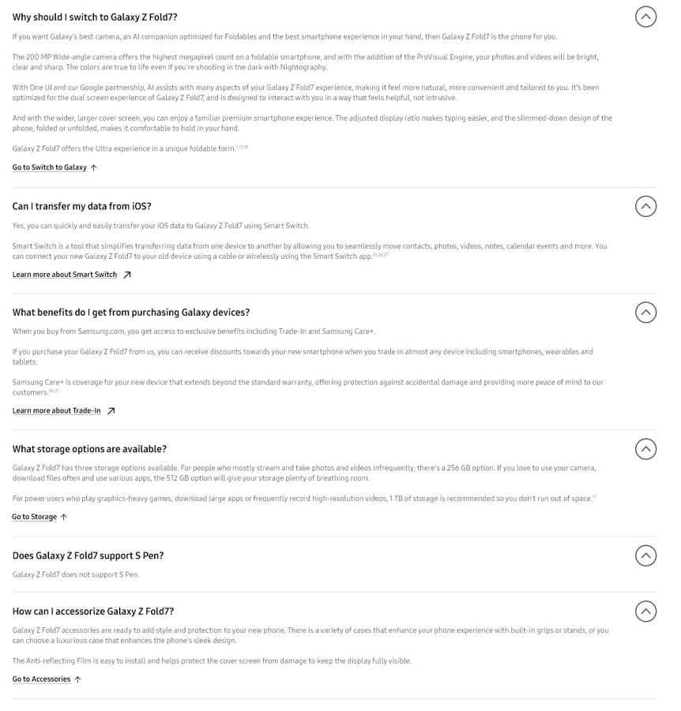
Features – FAQ (3/3)
9
10
11
12
13
No. |  | Tagging Source
9 |  | Click to go to Performance feature in Features page
 | AA | data-omni-type="microsite_contentinter" data-omni="galaxy-z-fold7:features:faq^switch-to-galaxy:link-anchor:switch-to-galaxy"
 | GA | ga-ca="content click" ga-ac="feature" ga-la="galaxy-z-fold7:features:faq^switch-to-galaxy:link-anchor:switch-to-galaxy"
10 |  | Click to go to Smart Switch page
 | AA | data-omni-type="microsite_contentinter" data-omni="galaxy-z-fold7:features:faq^smart-switch:link-page:smart-switch"
 | GA | ga-ca="content click" ga-ac="feature" ga-la="galaxy-z-fold7:features:faq^smart-switch:link-page:smart-switch"
11 |  | Click to go to Trade in page
 | AA | data-omni-type="microsite_contentinter" data-omni="galaxy-z-fold7:features:faq^trade-in:link-page:trade-in"
 | GA | ga-ca="content click" ga-ac="feature" ga-la="galaxy-z-fold7:features:faq^trade-in:link-page:trade-in"
12 |  | Click to go to Storage Feature
 | AA | data-omni-type="microsite_contentinter" data-omni="galaxy-z-fold7:features:faq^storage:link-anchor:storage"
 | GA | ga-ca="content click" ga-ac="feature" ga-la="galaxy-z-fold7:features:faq^storage:link-anchor:storage"
13 |  | Click to go to Accessories Feature
 | AA | data-omni-type="microsite_contentinter" data-omni="galaxy-z-fold7:features:faq^accessories:link-anchor:accessories"
 | GA | ga-ca="content click" ga-ac="feature" ga-la="galaxy-z-fold7:features:faq^accessories:link-anchor:accessories"

Slide 49
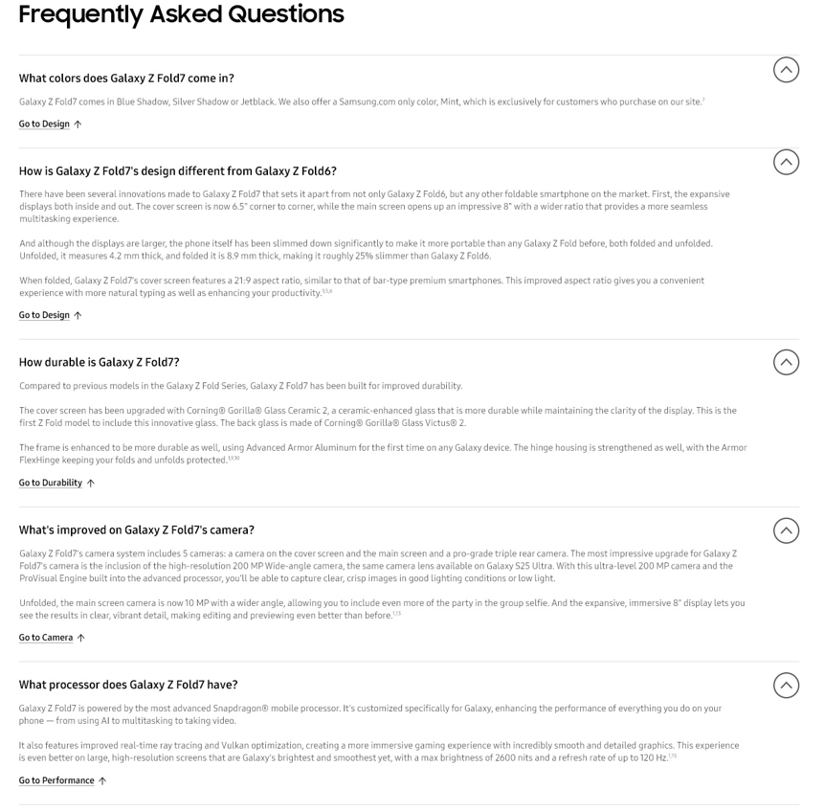
Features-FAQ (1/2)
1
2
3
4
5
No. |  | Tagging Source
1 |  | Click to close Colors FAQ
 | AA | data-omni-type="microsite_contentinter" data-omni="galaxy-z-fold7:features:faq:acdn-close:colors"
 | GA | ga-ca="indication" ga-ac="accordion" ga-la="galaxy-z-fold7:features:faq:acdn-close:colors"
2 |  | Click to close Design FAQ
 | AA | data-omni-type="microsite_contentinter" data-omni="galaxy-z-fold7:features:faq:acdn-close:design^compare"
 | GA | ga-ca="indication" ga-ac="accordion" ga-la="galaxy-z-fold7:features:faq:acdn-close:design^compare"
3 |  | Click to close urability FAQ
 | AA | data-omni-type="microsite_contentinter" data-omni="galaxy-z-fold7:features:faq:acdn-close:durability"
 | GA | ga-ca="indication" ga-ac="accordion" ga-la="galaxy-z-fold7:features:faq:acdn-close:durability"
4 |  | Click to close Camera FAQ
 | AA | data-omni-type="microsite_contentinter" data-omni="galaxy-z-fold7:features:faq:acdn-close:camera"
 | GA | ga-ca="indication" ga-ac="accordion" ga-la="galaxy-z-fold7:features:faq:acdn-close:camera"
5 |  | Click to close Performance FAQ
 | AA | data-omni-type="microsite_contentinter" data-omni="galaxy-z-fold7:features:faq:acdn-close:performance"
 | GA | ga-ca="indication" ga-ac="accordion" ga-la="galaxy-z-fold7:features:faq:acdn-close:performance"

Slide 50
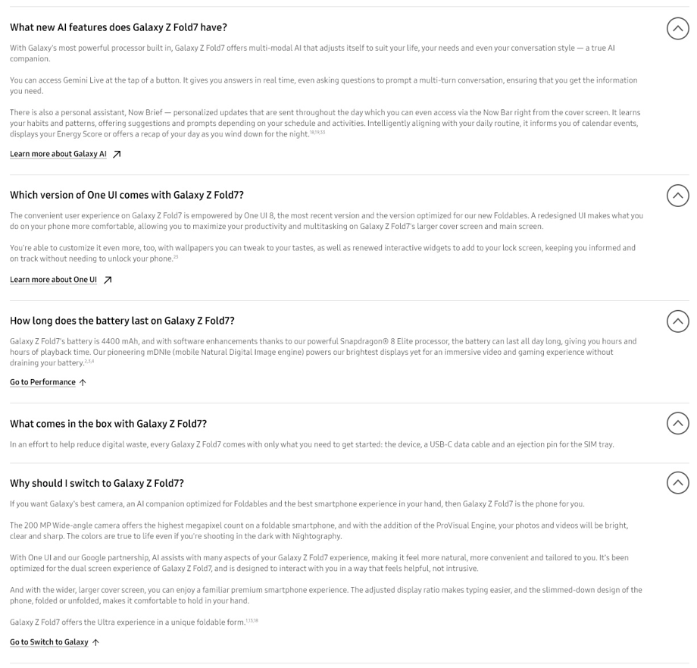
Features-FAQ (1/2)
6
7
8
9
10
No. |  | Tagging Source
6 |  | Click to close AI FAQ
 | AA | data-omni-type="microsite_contentinter" data-omni="galaxy-z-fold7:features:faq:acdn-close:ai"
 | GA | ga-ca="indication" ga-ac="accordion" ga-la="galaxy-z-fold7:features:faq:acdn-close:ai"
7 |  | Click to close One UI FAQ
 | AA | data-omni-type="microsite_contentinter" data-omni="galaxy-z-fold7:features:faq:acdn-close:one-ui"
 | GA | ga-ca="indication" ga-ac="accordion" ga-la="galaxy-z-fold7:features:faq:acdn-close:one-ui"
8 |  | Click to close Battery FAQ
 | AA | data-omni-type="microsite_contentinter" data-omni="galaxy-z-fold7:features:faq:acdn-close:battery"
 | GA | ga-ca="indication" ga-ac="accordion" ga-la="galaxy-z-fold7:features:faq:acdn-close:battery"
9 |  | Click to close Whats in the box FAQ
 | AA | data-omni-type="microsite_contentinter" data-omni="galaxy-z-fold7:features:faq:acdn-close:whats-in-the-box"
 | GA | ga-ca="indication" ga-ac="accordion" ga-la="galaxy-z-fold7:features:faq:acdn-close:whats-in-the-box"
10 |  | Click to close Switch to galaxy FAQ
 | AA | data-omni-type="microsite_contentinter" data-omni="galaxy-z-fold7:features:faq:acdn-close:switch-to-galaxy"
 | GA | ga-ca="indication" ga-ac="accordion" ga-la="galaxy-z-fold7:features:faq:acdn-close:switch-to-galaxy"

Slide 51
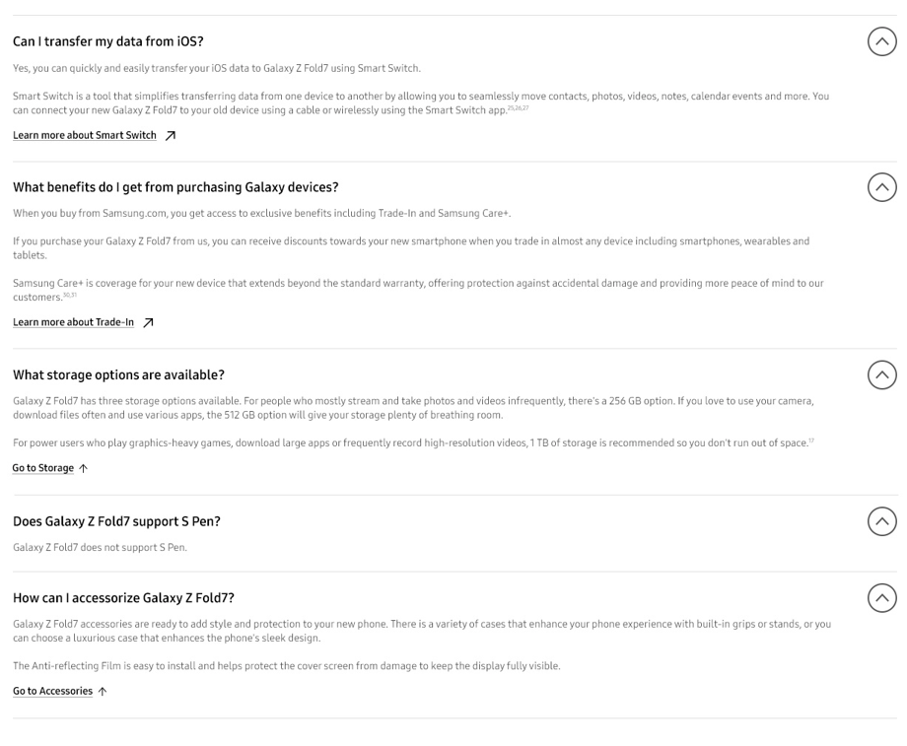
Features-FAQ (1/2)
11
12
13
14
15
No. |  | Tagging Source
11 |  | Click to close Smart Switch FAQ
 | AA | data-omni-type="microsite_contentinter" data-omni="galaxy-z-fold7:features:faq:acdn-close:smart-switch"
 | GA | ga-ca="indication" ga-ac="accordion" ga-la="galaxy-z-fold7:features:faq:acdn-close:smart-switch"
12 |  | Click to close Trade in FAQ
 | AA | data-omni-type="microsite_contentinter" data-omni="galaxy-z-fold7:features:faq:acdn-close:trade-in"
 | GA | ga-ca="indication" ga-ac="accordion" ga-la="galaxy-z-fold7:features:faq:acdn-close:trade-in"
13 |  | Click to close Storage FAQ
 | AA | data-omni-type="microsite_contentinter" data-omni="galaxy-z-fold7:features:faq:acdn-close:storage"
 | GA | ga-ca="indication" ga-ac="accordion" ga-la="galaxy-z-fold7:features:faq:acdn-close:storage"
14 |  | Click to close S Pen FAQ
 | AA | data-omni-type="microsite_contentinter" data-omni="galaxy-z-fold7:features:faq:acdn-close:s-pen"
 | GA | ga-ca="indication" ga-ac="accordion" ga-la="galaxy-z-fold7:features:faq:acdn-close:s-pen"
15 |  | Click to close Accessories FAQ
 | AA | data-omni-type="microsite_contentinter" data-omni="galaxy-z-fold7:features:faq:acdn-close:accessories"
 | GA | ga-ca="indication" ga-ac="accordion" ga-la="galaxy-z-fold7:features:faq:acdn-close:accessories"

Slide 52

Features – Bottom Disclaimer
1
2
No. |  | Tagging Source
1 |  | Click to go Samsung business Page
 | AA | data-omni-type="microsite_contentinter" data-omni="galaxy-z-fold7:features:bottom^bnn:link-page:business-site"
 | GA | ga-ca="content click" ga-ac="feature" ga-la="galaxy-z-fold7:features:bottom^bnn:link-page:business-site"
2 |  | Click to return Feature
 | AA | data-omni-type="microsite_contentinter" data-omni="galaxy-z-fold7:features:disclaimer:slct-tap:go-to-top"
 | GA | ga-ca="content click" ga-ac="feature" ga-la="galaxy-z-fold7:features:disclaimer:slct-tap:go-to-top"

Slide 53
Compare

Slide 54
Page Track
1
2
3
5
4
7
6
8
10
9
No. | Tagging Source
1 | {depth2}
 | try {digitalData.page.pathIndicator.depth_2 = "mobile";} catch (e) {}
2 | {depth3}
 | try {digitalData.page.pathIndicator.depth_3 = "smartphones";} catch (e) {}
3 | {depth4}
 | try {digitalData.page.pathIndicator.depth_4 = "galaxy z";} catch (e) {}
4 | {depth5}
 | try {digitalData.page.pathIndicator.depth_5 = "galaxy-z-fold7";} catch (e) {}
5 | {pvi_type_neme}
 | try {digitalData.product.pvi_type_name = "Mobile";} catch (e) {}
6 | {pvi_sub_type_name}
 | try {digitalData.product.pvi_subtype_name = "Smartphone";} catch (e) {}
7 | {model_name}
 | try {digitalData.product.model_name = "SM-F966";} catch (e) {}
8 | {display_name}
 | try {digitalData.product.displayName = "galaxy z fold7";} catch (e) {}
9 | {category}
 | try {digitalData.product.category = digitalData.page.pathIndicator.depth_2;} catch (e) {}
10 | {pd_sub_type}
 | try {digitalData.product.pd_sub_type = "galaxy z";} catch (e) {}
Notes:
[Reference Code]
try {digitalData.page.pathIndicator.depth_2 = "mobile";} catch (e) {}
try {digitalData.page.pathIndicator.depth_3 = "smartphones";} catch (e) {}
try {digitalData.page.pathIndicator.depth_4 = "galaxy z";} catch (e) {}
try {digitalData.page.pathIndicator.depth_5 = "galaxy-zfold-7";} catch (e) {}
try {digitalData.product.pvi_type_name = "Mobile";} catch (e) {}
try {digitalData.product.pvi_subtype_name = "Smartphone";} catch (e) {}
try {digitalData.product.model_name = "SM-z937";} catch (e) {}
try {digitalData.product.displayName = "galaxy zfold7 ";} catch (e) {}
try {digitalData.product.category = digitalData.page.pathIndicator.depth_2;} catch (e) {}
try {digitalData.product.pd_sub_type = "galaxy z";} catch (e) {}

Slide 55

Compare - Main
1
No. |  | Tagging Source
1 |  | Click to open – View more
 | AA | data-omni-type="microsite_contentinter" data-omni="galaxy-z-fold7:compare:all-tech-spec:view-more-all-tech-open"
 | GA | ga-ca="content click" ga-ac="feature" ga-la="galaxy-z-fold7:compare:all-tech-spec:view-more-all-tech-open"
2 |  | Click to close – View more
 | AA | data-omni-type="microsite_contentinter" data-omni="galaxy-z-fold7:compare:all-tech-spec:view-more-all-tech-close"
 | GA | ga-ca="content click" ga-ac="feature" ga-la="galaxy-z-fold7:compare:all-tech-spec:view-more-all-tech-close"

Slide 56

Compare - FAQ
1
2
3
4
5
6
7
No. |  | Tagging Source
1 |  | Click to open – Design
 | AA | data-omni-type="microsite_contentinter" data-omni="galaxy-z-fold7:compare:faq:acdn-open:design"
 | GA | ga-ca="indication" ga-ac="accordion" ga-la="galaxy-z-fold7:compare:faq:acdn-open:design"
 |  | Click to close – Design
 | AA | data-omni-type="microsite_contentinter" data-omni="galaxy-z-fold7:compare:faq:acdn-close:design"
 | GA | ga-ca="indication" ga-ac="accordion" ga-la="galaxy-z-fold7:compare:faq:acdn-close:design"
2 |  | Click to open – Camera
 | AA | data-omni-type="microsite_contentinter" data-omni="galaxy-z-fold7:compare:faq:acdn-open:camera"
 | GA | ga-ca="indication" ga-ac="accordion" ga-la="galaxy-z-fold7:compare:faq:acdn-open:camera"
 |  | Click to close – Camera
 | AA | data-omni-type="microsite_contentinter" data-omni="galaxy-z-fold7:compare:faq:acdn-close:camera"
 | GA | ga-ca="indication" ga-ac="accordion" ga-la="galaxy-z-fold7:compare:faq:acdn-close:camera"
3 |  | Click to open – Processor
 | AA | data-omni-type="microsite_contentinter" data-omni="galaxy-z-fold7:compare:faq:acdn-open:processor"
 | GA | ga-ca="indication" ga-ac="accordion" ga-la="galaxy-z-fold7:compare:faq:acdn-open:processor"
 |  | Click to close – Processor
 | AA | data-omni-type="microsite_contentinter" data-omni="galaxy-s25-edge:compare:faq:acdn-close:processor"
 | GA | ga-ca="indication" ga-ac="accordion" ga-la="galaxy-s25-edge:compare:faq:acdn-close:processor"
4 |  | Click to open - Memory
 | AA | data-omni-type="microsite_contentinter" data-omni="galaxy-s25-edge:compare:faq:acdn-open:memory"
 | GA | ga-ca="indication" ga-ac="accordion" ga-la="galaxy-s25-edge:compare:faq:acdn-open:memory"
 |  | Click to close - Memory
 | AA | data-omni-type="microsite_contentinter" data-omni="galaxy-s25-edge:compare:faq:acdn-close:memory"
 | GA | ga-ca="indication" ga-ac="accordion" ga-la="galaxy-s25-edge:compare:faq:acdn-close:memory"

Slide 57
Compare - FAQ
No. |  | Tagging Source
5 |  | Click to open – Size
 | AA | data-omni-type="microsite_contentinter" data-omni="galaxy-z-fold7:compare:faq:acdn-open:size"
 | GA | ga-ca="indication" ga-ac="accordion" ga-la="galaxy-z-fold7:compare:faq:acdn-open:size"
 |  | Click to close – Size
 | AA | data-omni-type="microsite_contentinter" data-omni="galaxy-z-fold7:compare:faq:acdn-close:size"
 | GA | ga-ca="indication" ga-ac="accordion" ga-la="galaxy-z-fold7:compare:faq:acdn-close:size"
6 |  | Click to open - Battery
 | AA | data-omni-type="microsite_contentinter" data-omni="galaxy-z-fold7:compare:faq:acdn-open:battery"
 | GA | ga-ca="indication" ga-ac="accordion" ga-la="galaxy-z-fold7:compare:faq:acdn-open:battery"
 |  | Click to close – Battery
 | AA | data-omni-type="microsite_contentinter" data-omni="galaxy-z-fold7:compare:faq:acdn-close:battery"
 | GA | ga-ca="indication" ga-ac="accordion" ga-la="galaxy-z-fold7:compare:faq:acdn-close:battery"
7 |  | Click to open - Display
 | AA | data-omni-type="microsite_contentinter" data-omni="galaxy-z-fold7:compare:faq:acdn-open:display"
 | GA | ga-ca="indication" ga-ac="accordion" ga-la="galaxy-z-fold7:compare:faq:acdn-open:display"
 |  | Click to close – Display
 | AA | data-omni-type="microsite_contentinter" data-omni="galaxy-z-fold7:compare:faq:acdn-close:display"
 | GA | ga-ca="indication" ga-ac="accordion" ga-la="galaxy-z-fold7:compare:faq:acdn-close:display"

Slide 58

Compare - Disclaimer
1
No. |  | Tagging Source
1 |  | Click to CTA – Go to top
 | AA | data-omni-type="microsite_contentinter" data-omni="galaxy-z-fold7:compare:disclaimer:slct-tap:go-to-top"
 | GA | ga-ca="content click" ga-ac="feature" ga-la="galaxy-z-fold7:compare:disclaimer:slct-tap:go-to-top"

Slide 59
EOD

